Slide 1
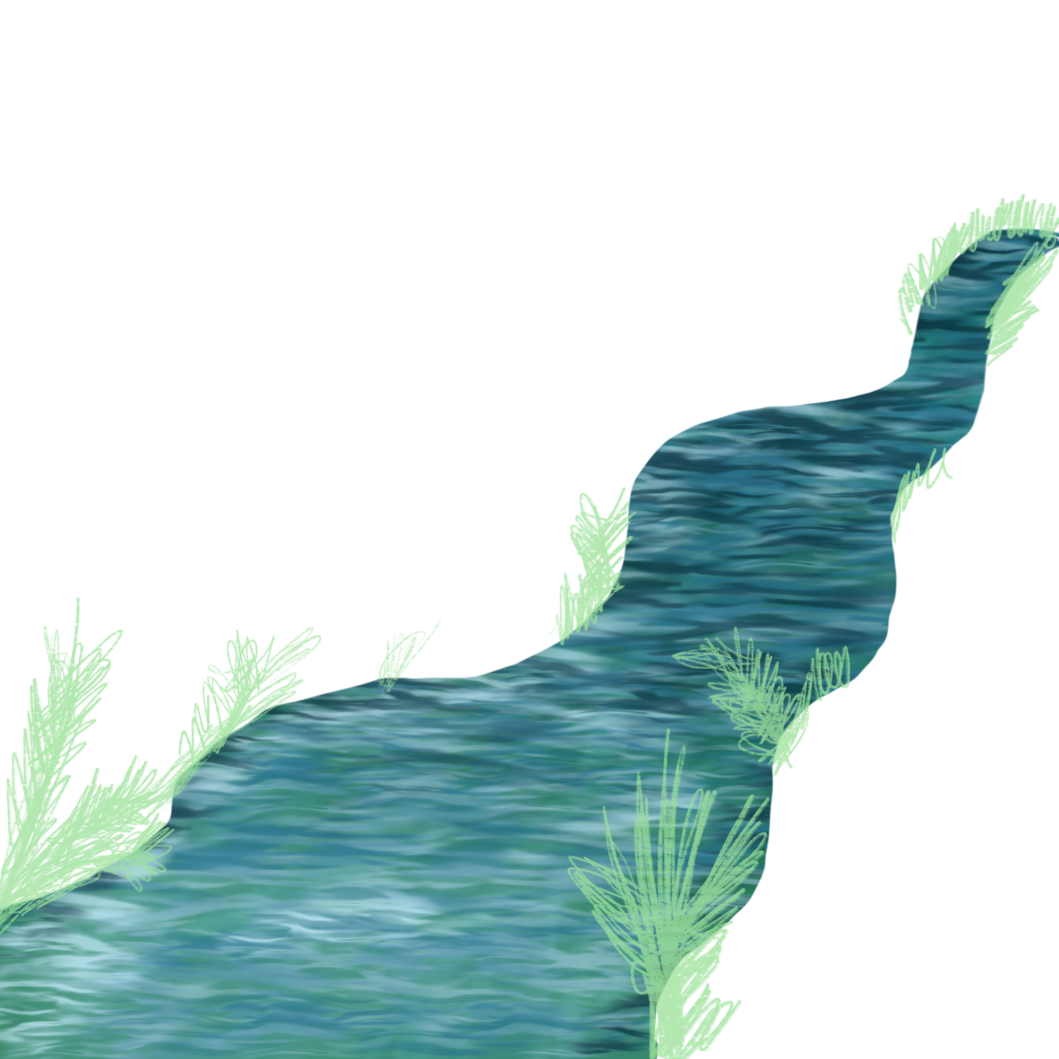
Sommercamp `24
Organized by
Oskara Kalpaka High School, Liepaja
Documented by Daniels Derkevics

Slide 2
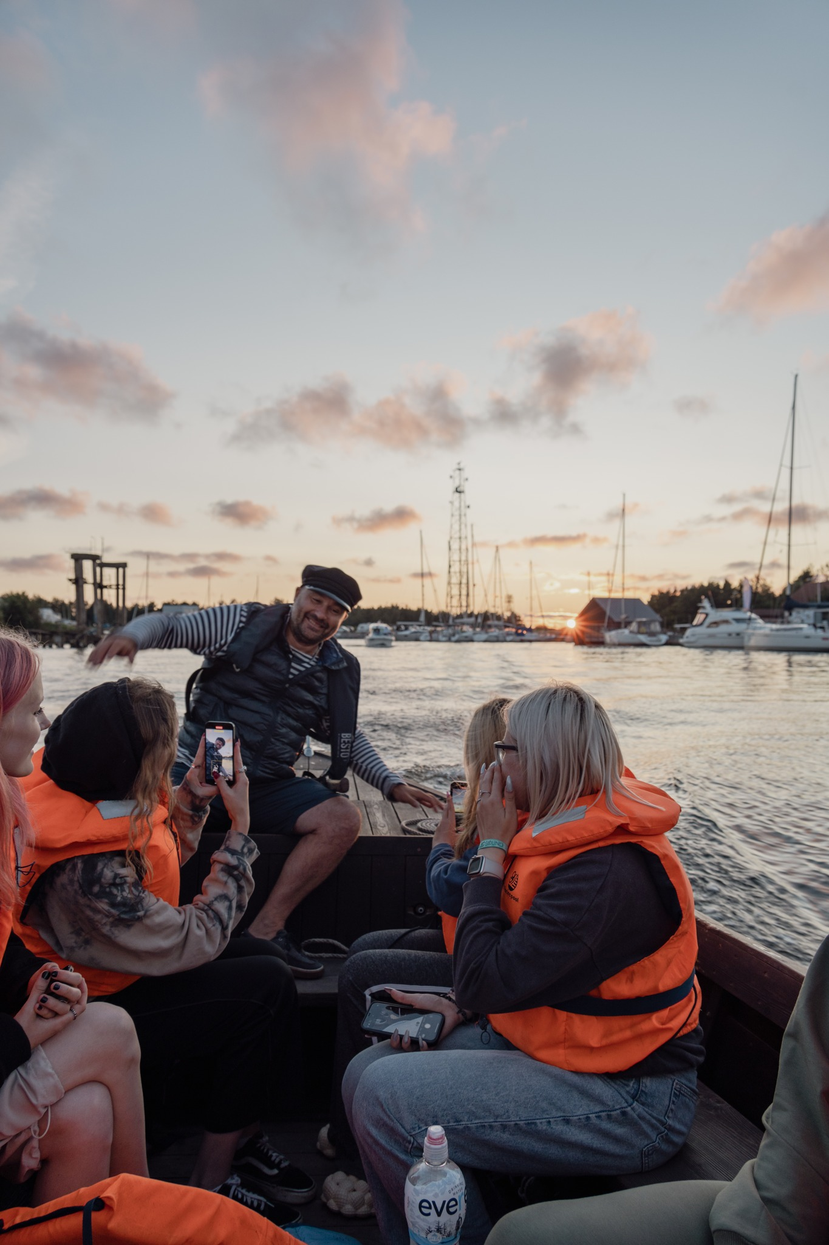
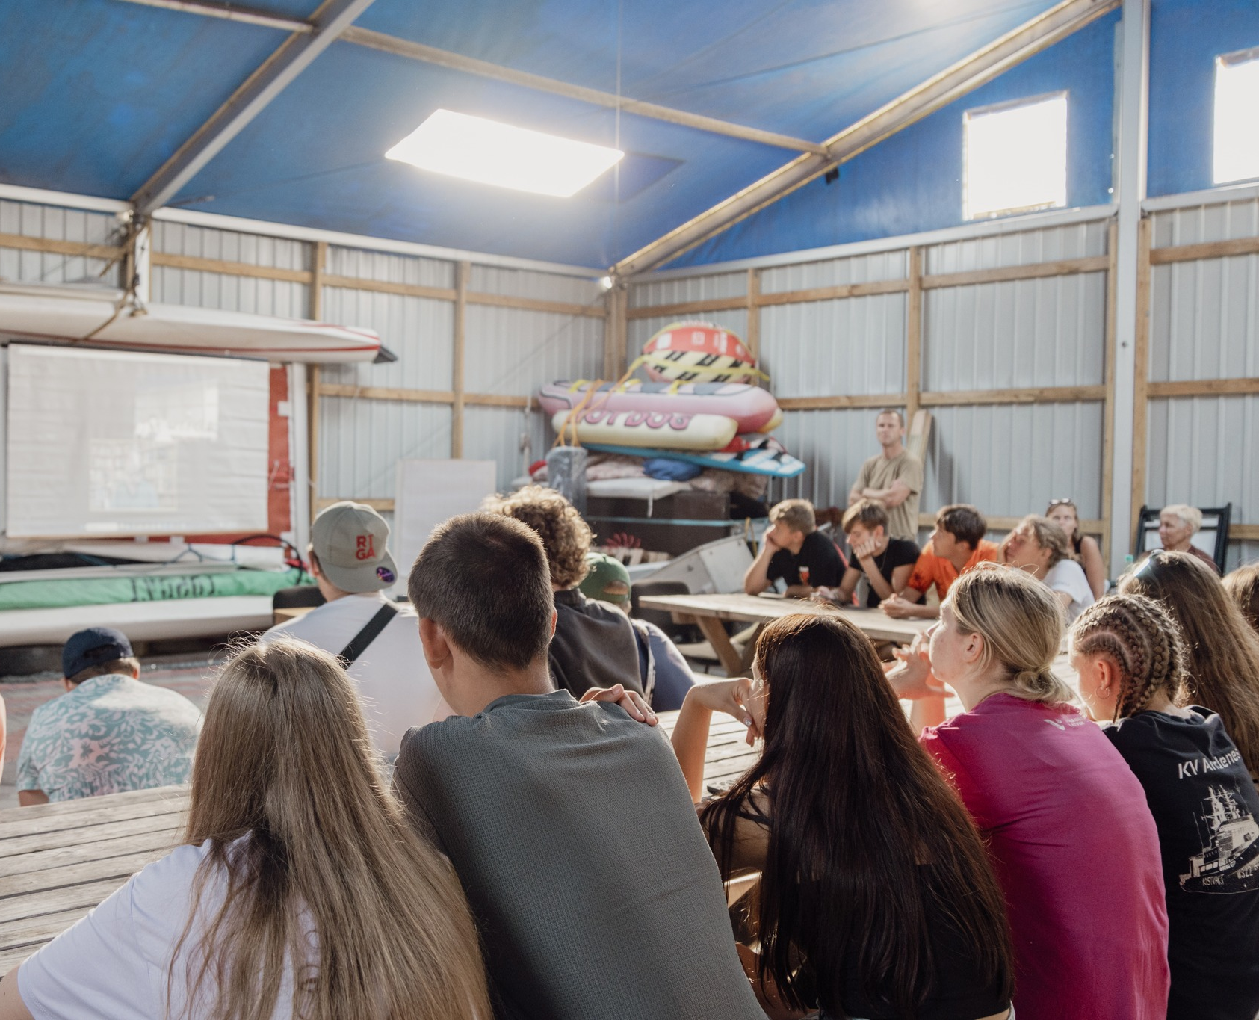
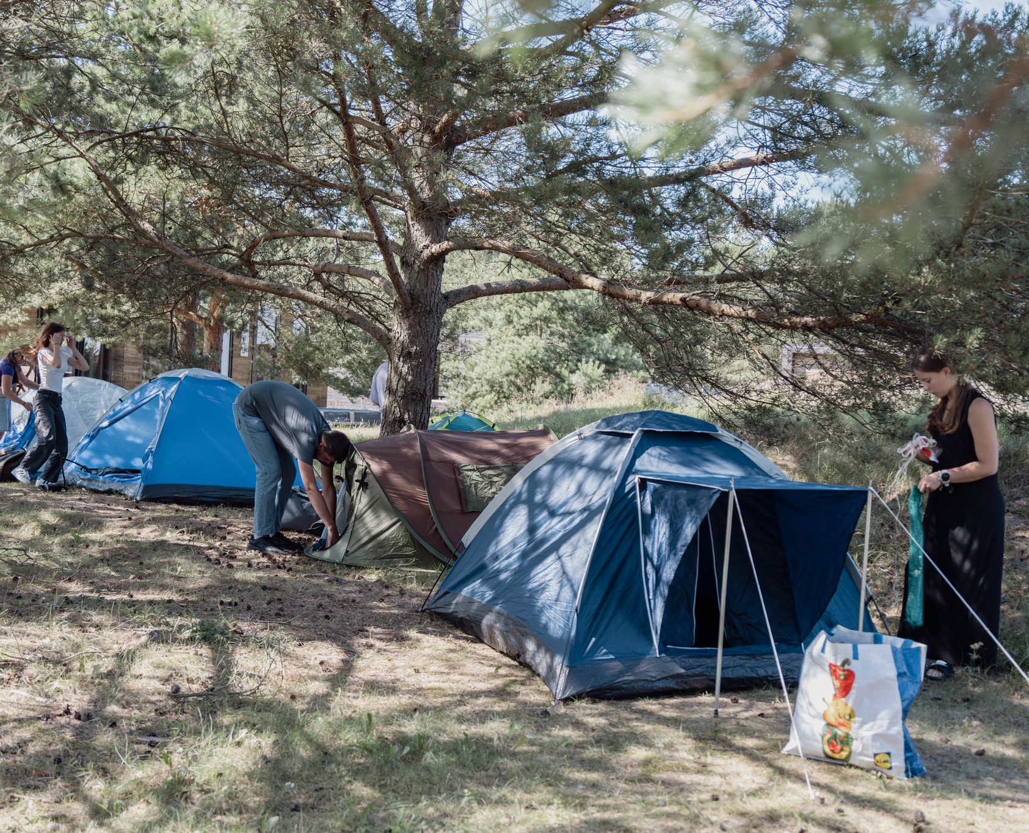
1st day of the camp
Oskara Kalpaka High School's summer camp 2024 took place in Pāvilosta with students from Paderborn, DE.
Participants visited the Pāvilosta Local History Museum and engage in virtual fishing.
Dr. Michael Lönz discussed Pāvilosta's history, followed by a boat trip on the Saka River.

Slide 3
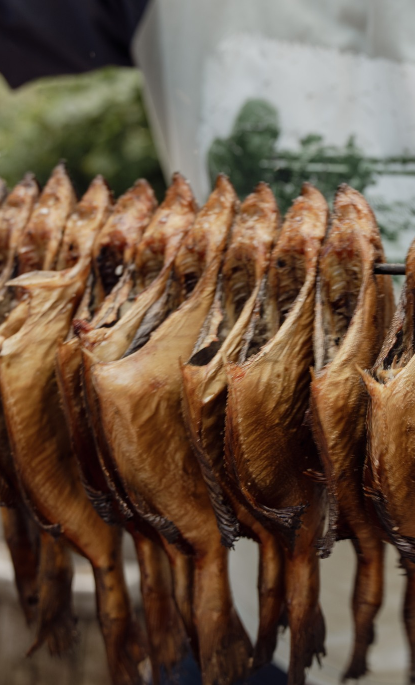
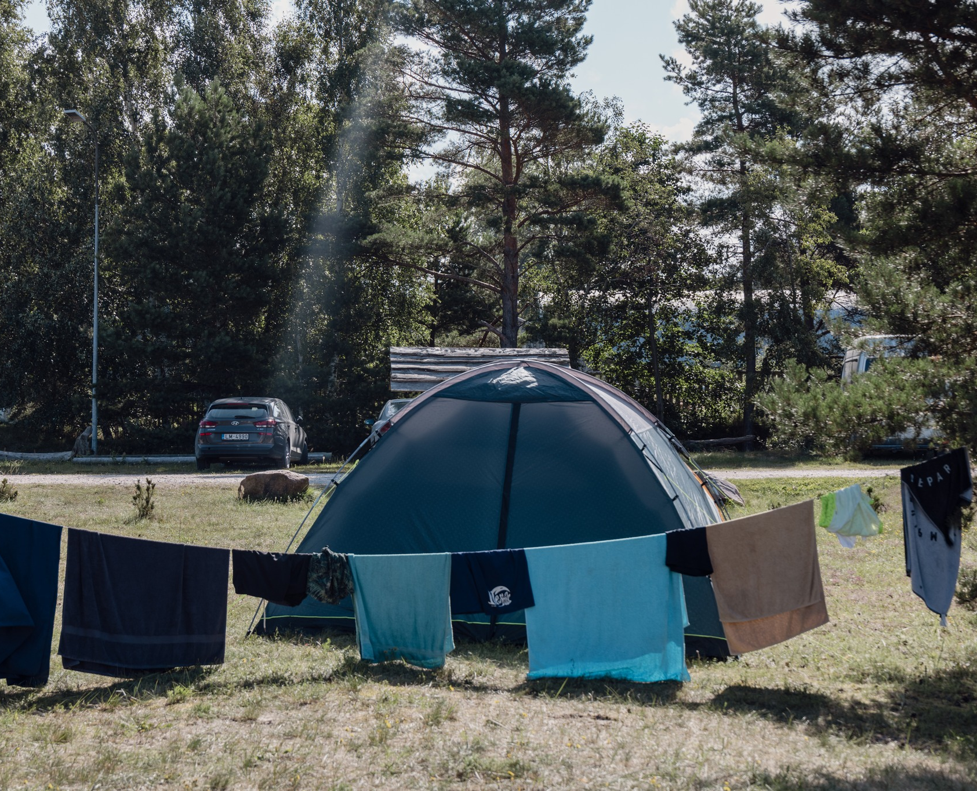
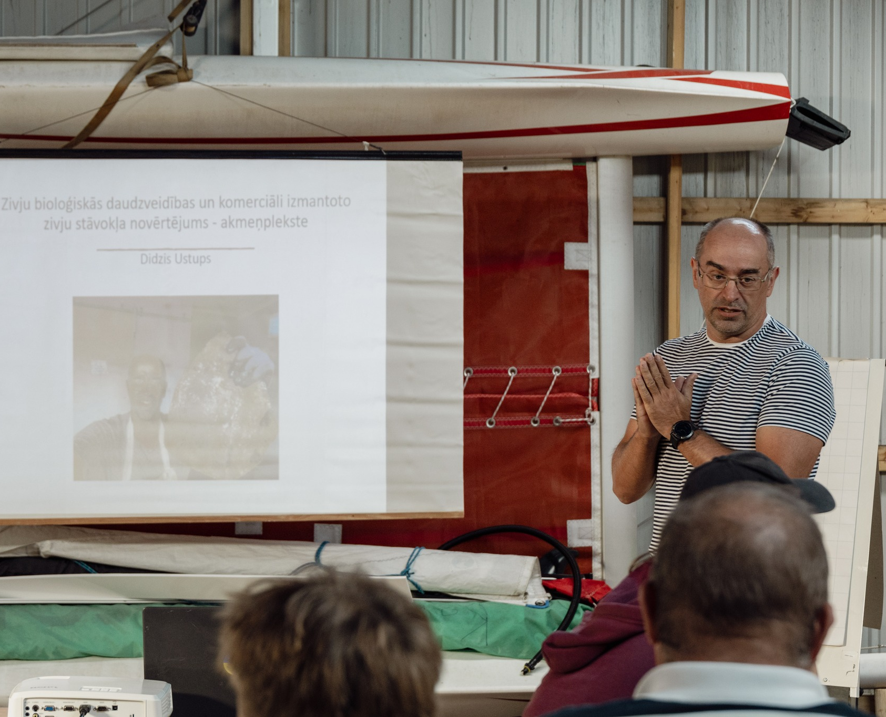
2nd day of the camp
The second day of the Latvian Fish Fund's summer camp focused on fish biodiversity, with Dr. Didzis Ustups discussing commercially exploited species like flounder.
Participants conducted fish fry counts along the Baltic Sea coast and learned about the eel life cycle from BIOR researcher Kaspars Abersons.
Dzintars Zamarītis led a masterclass on fish smoking, and Ģirts Vagotiņš-Vagulis shared stories about Pāvilosta's fishing history.

Slide 4
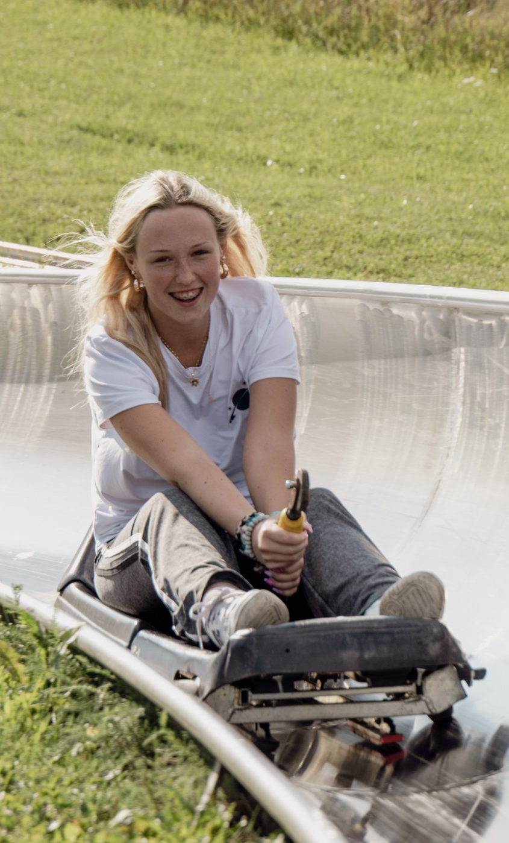
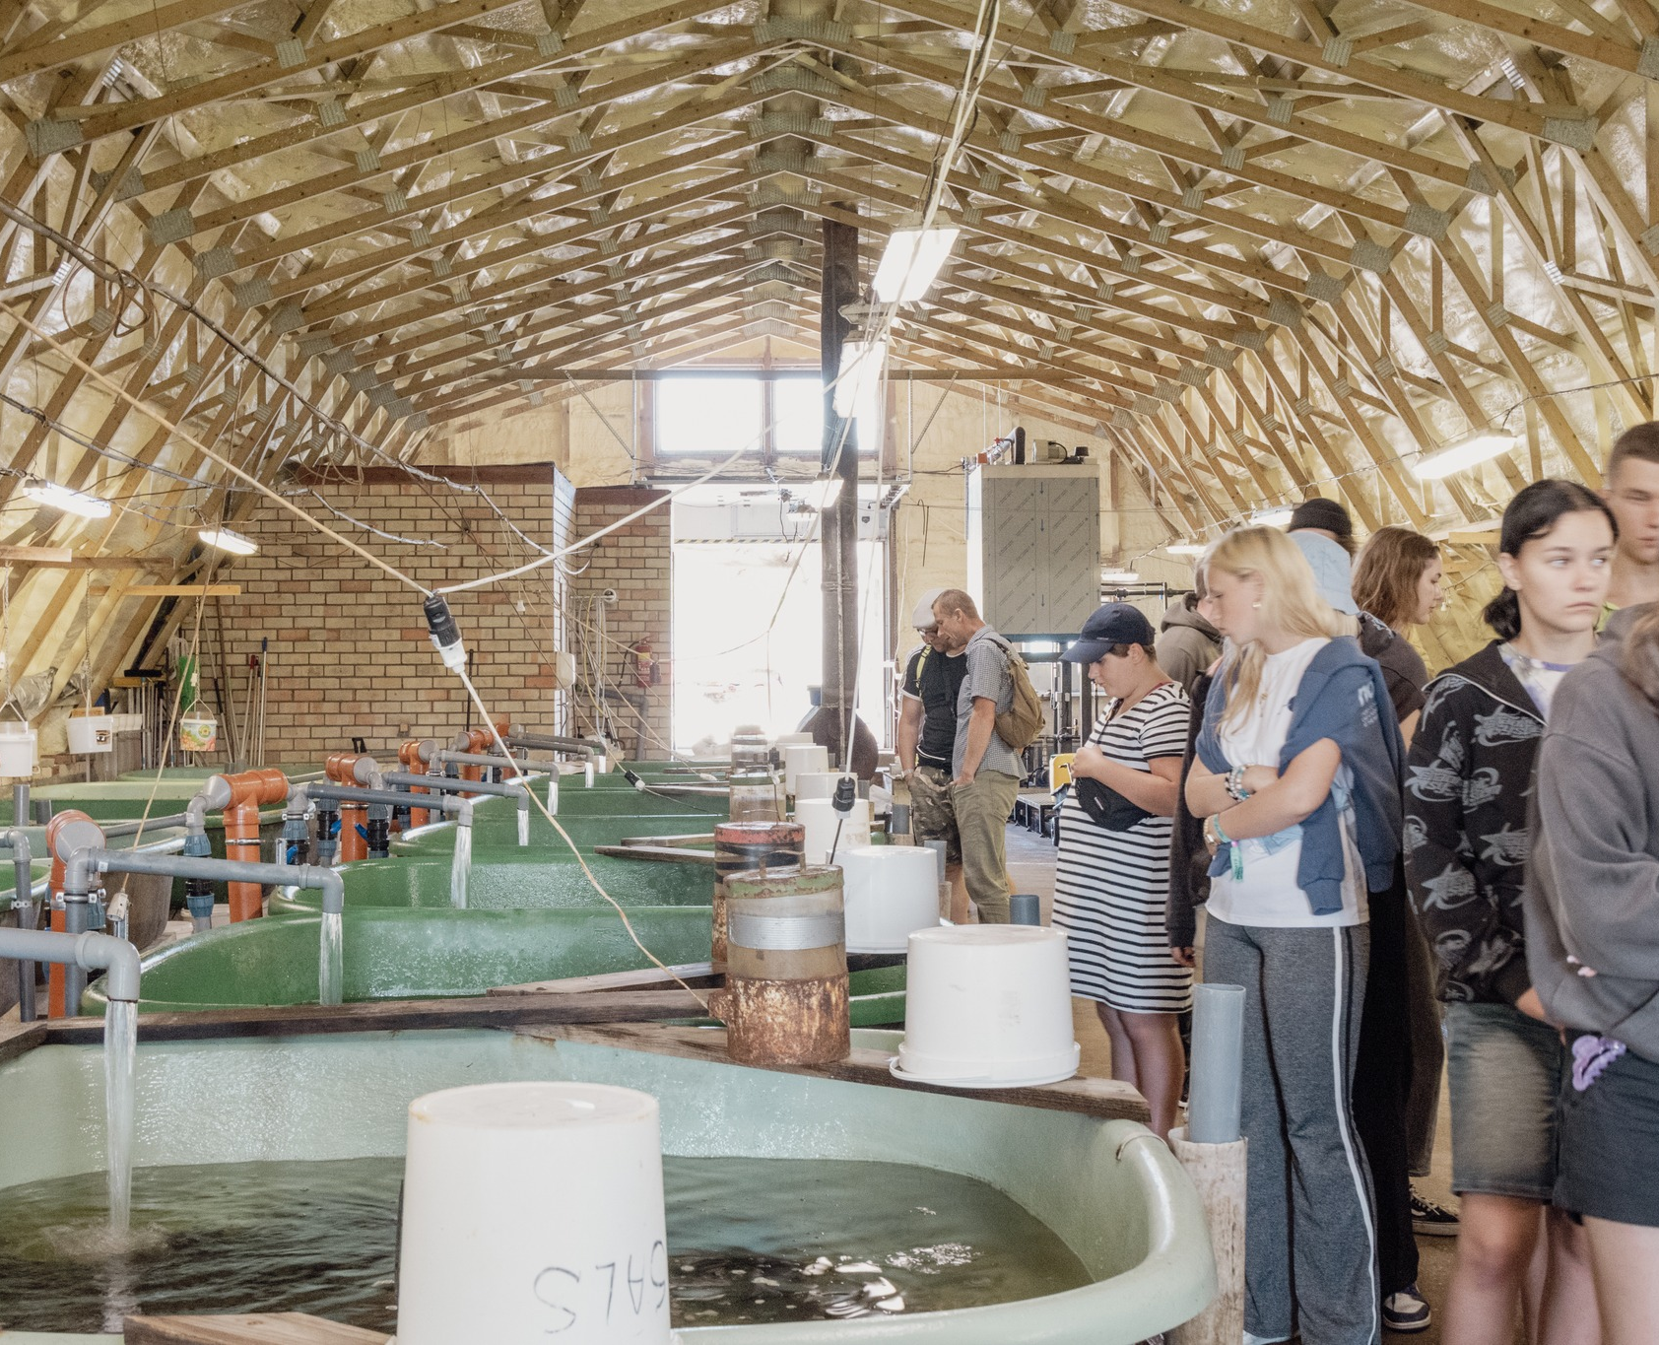
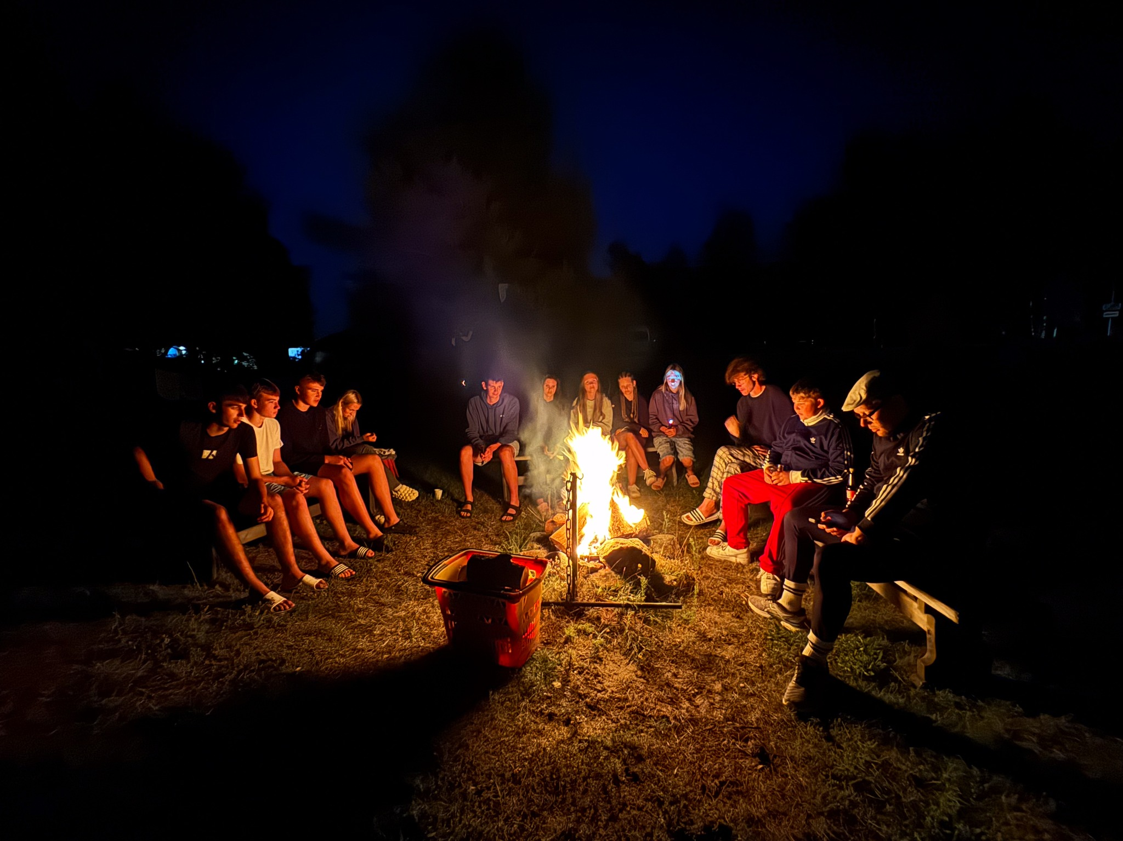
3rd day of the camp
The third day featured excursions, starting at the "Tome" fish hatchery, where participants learned about salmon and trout farming.
In Kandava, campers visited the local museum and enjoyed acorn coffee.
The day ended with friendship sports games at Zviedru cepure and discussions around the campfire.

Slide 5
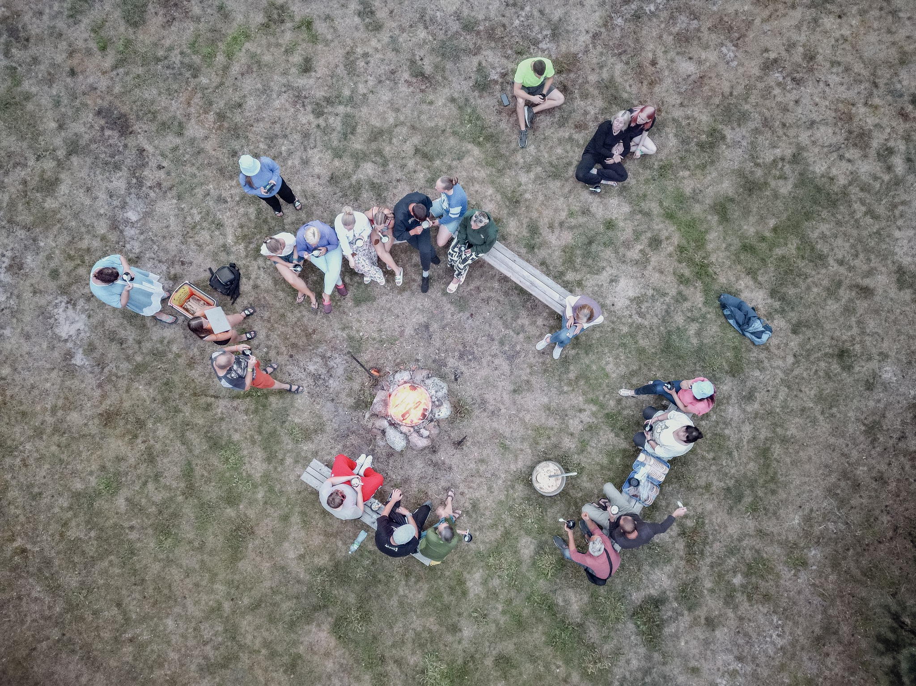
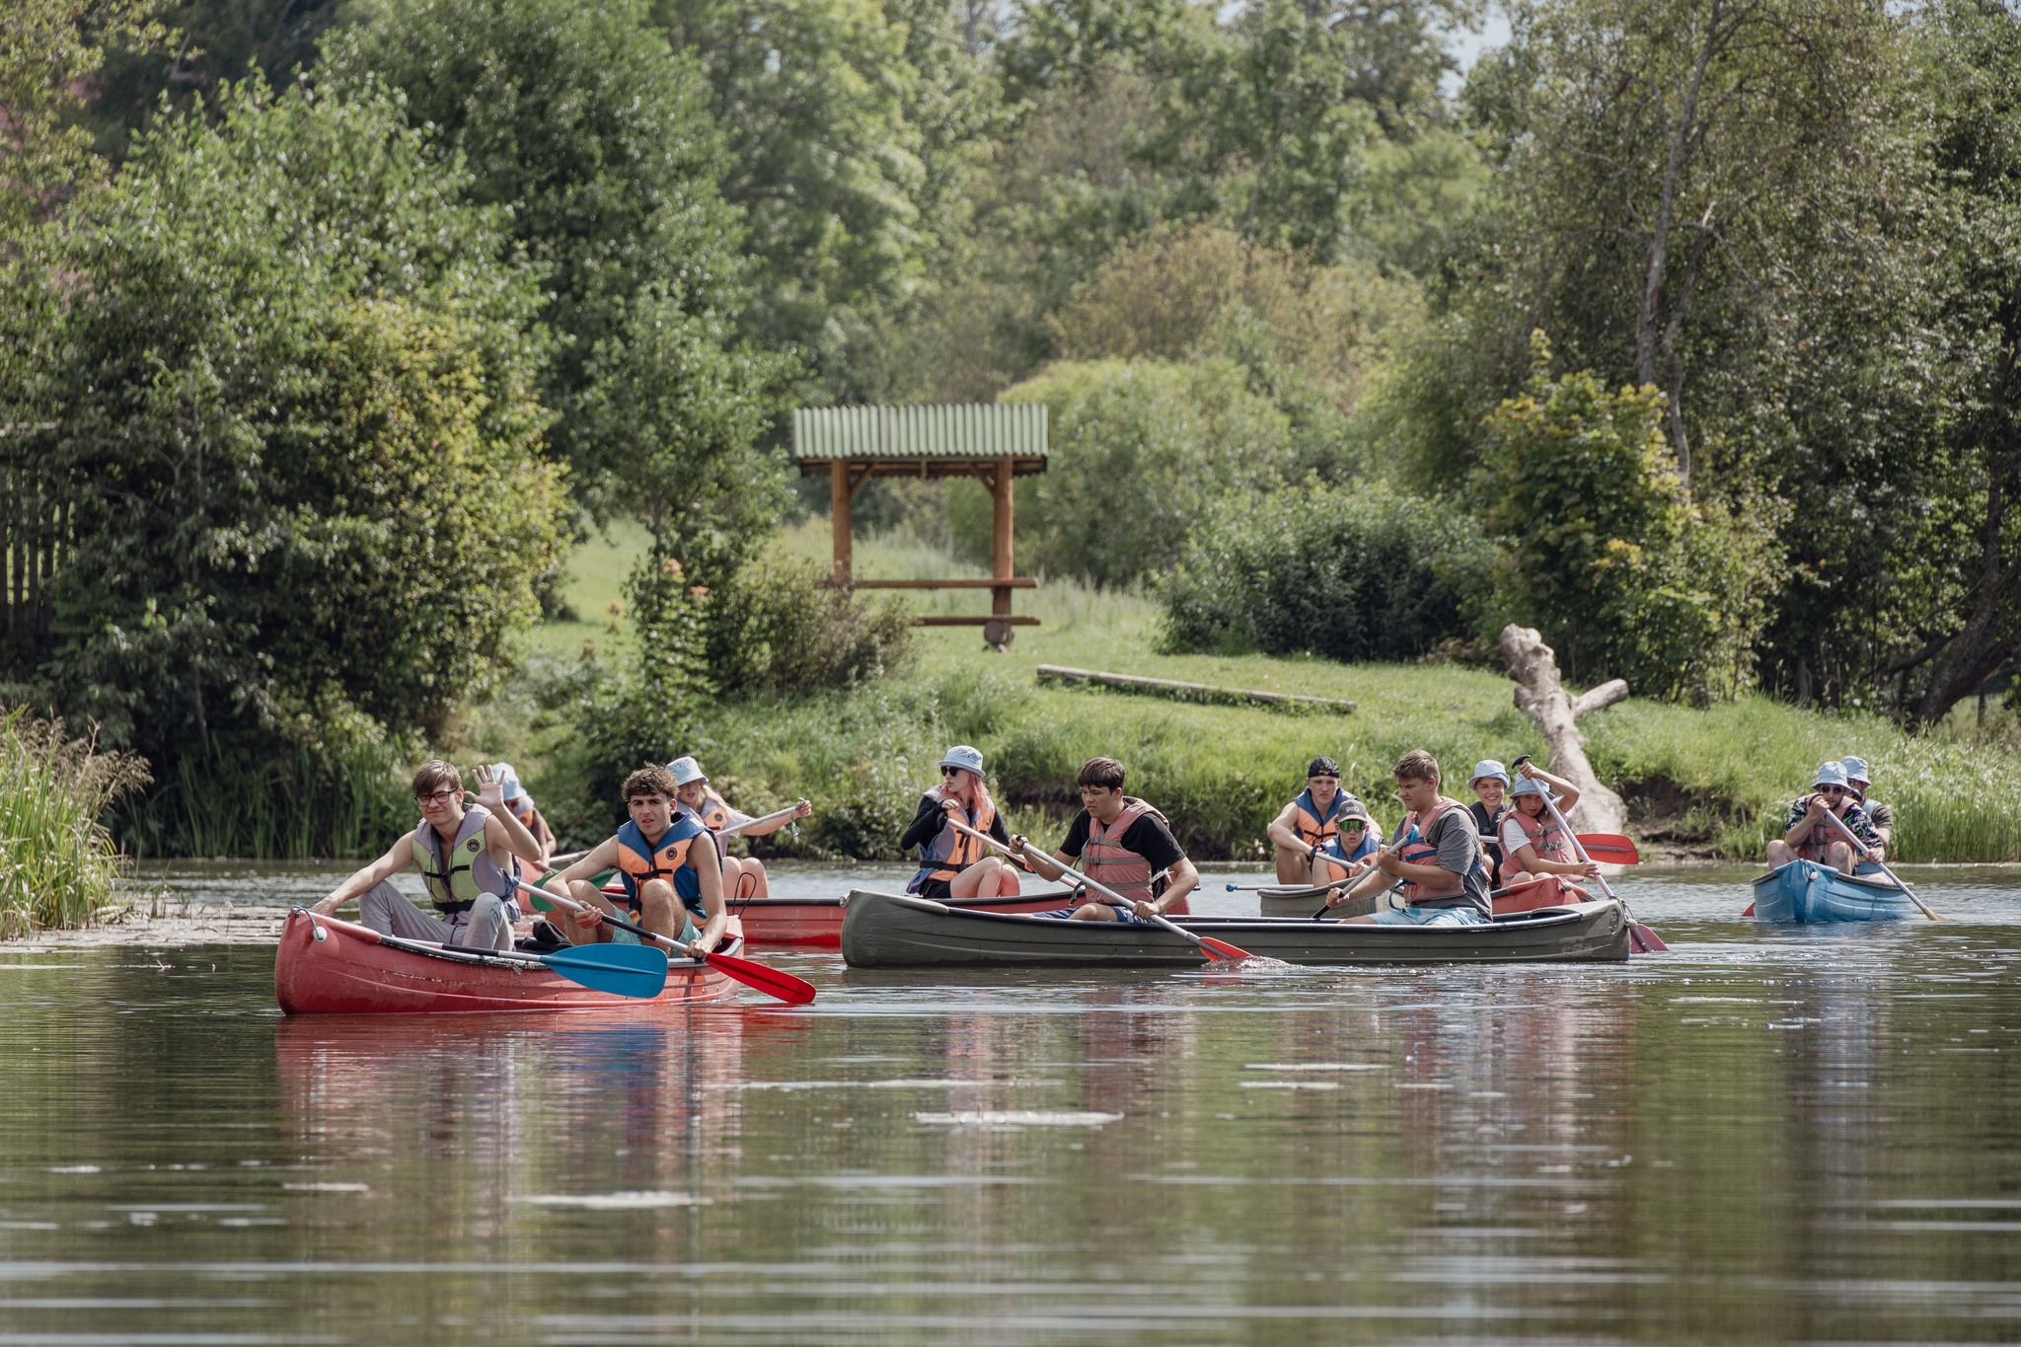
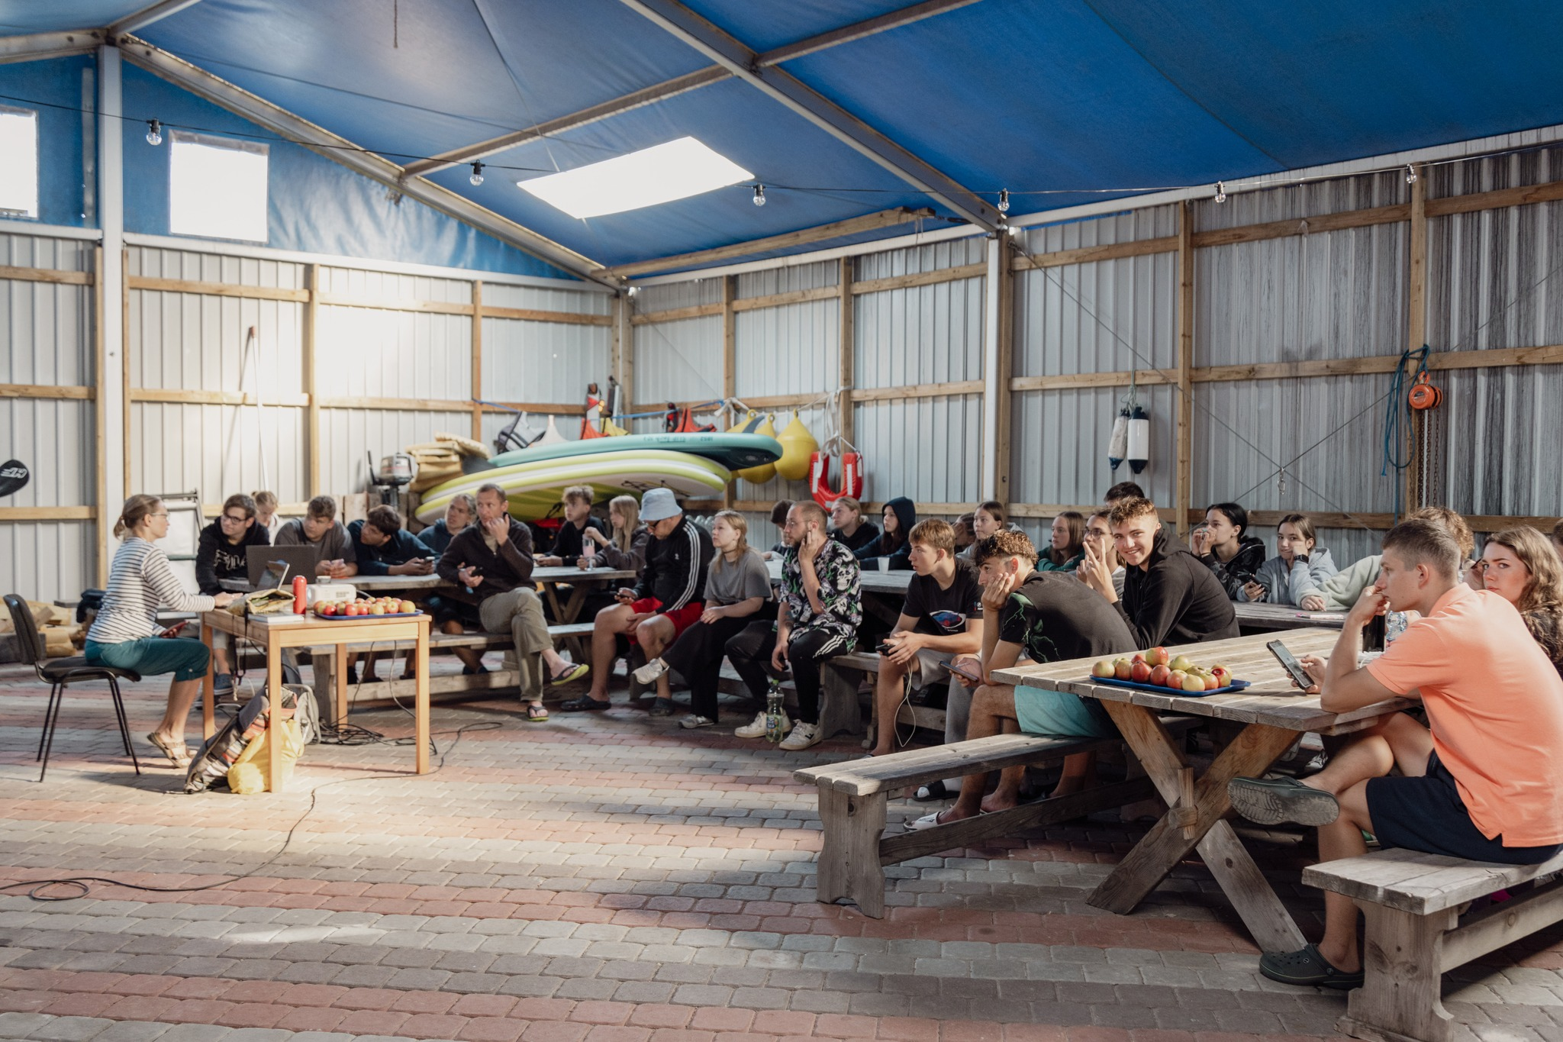
4th day of the camp
The day began with a session on coastal fishing culture by PhD Guntra Aistare, encouraging students to gather family stories.
Participants discussed the challenges of coastal fishing with entrepreneur Jānis Peterman.
The day ended with canoeing on the Saka River and traditional fish soup by Ēvalds Urtāns, followed by campfire conversations about next year's plans.

