Slide 1
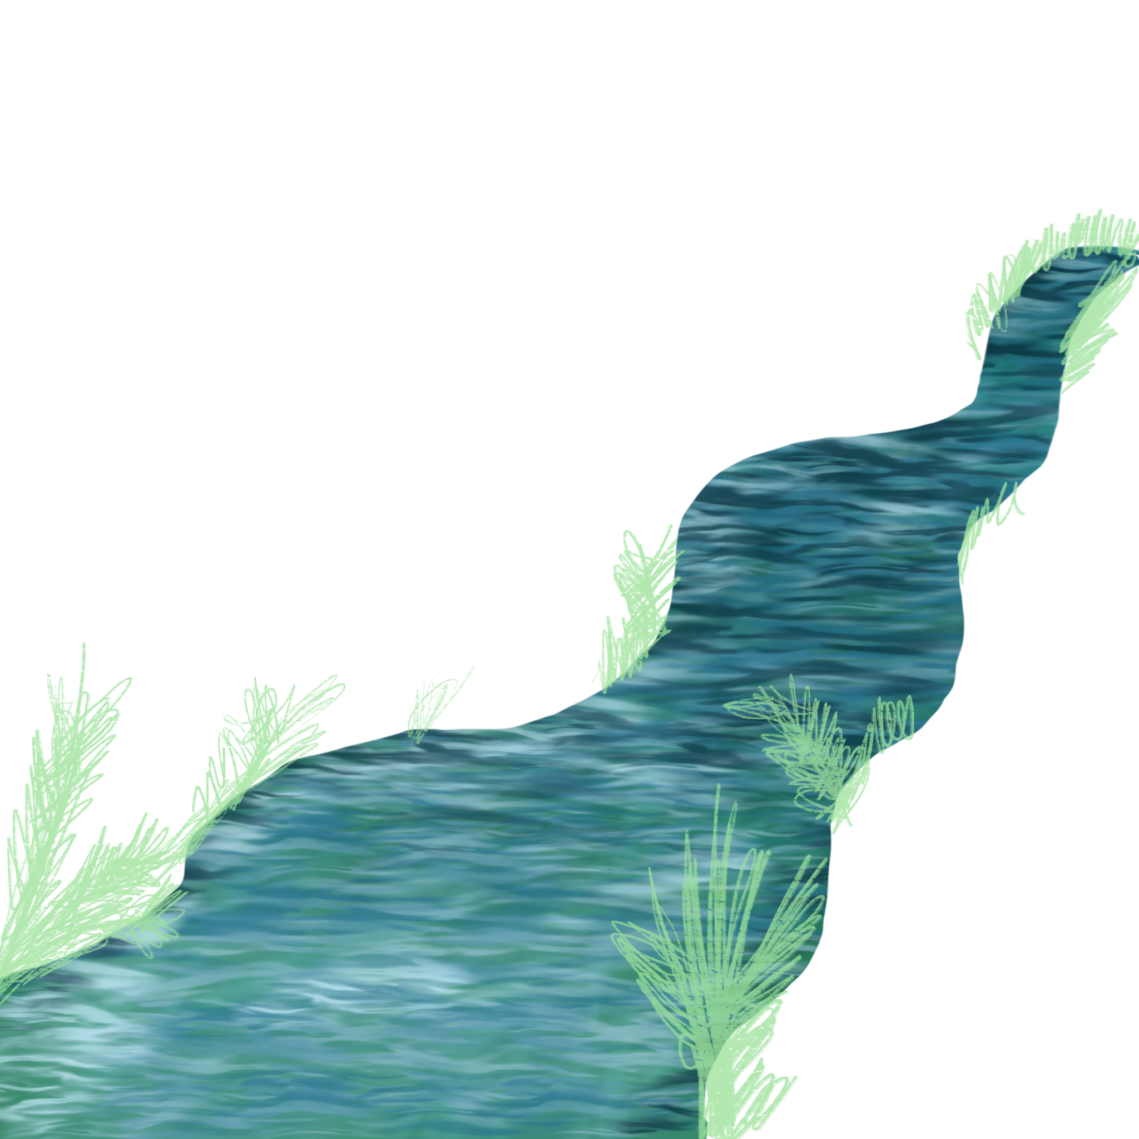
Sommercamp `23
Organized by
Oskara Kalpaka High School, Liepaja
Documented by Daniels Derkevics

Slide 2
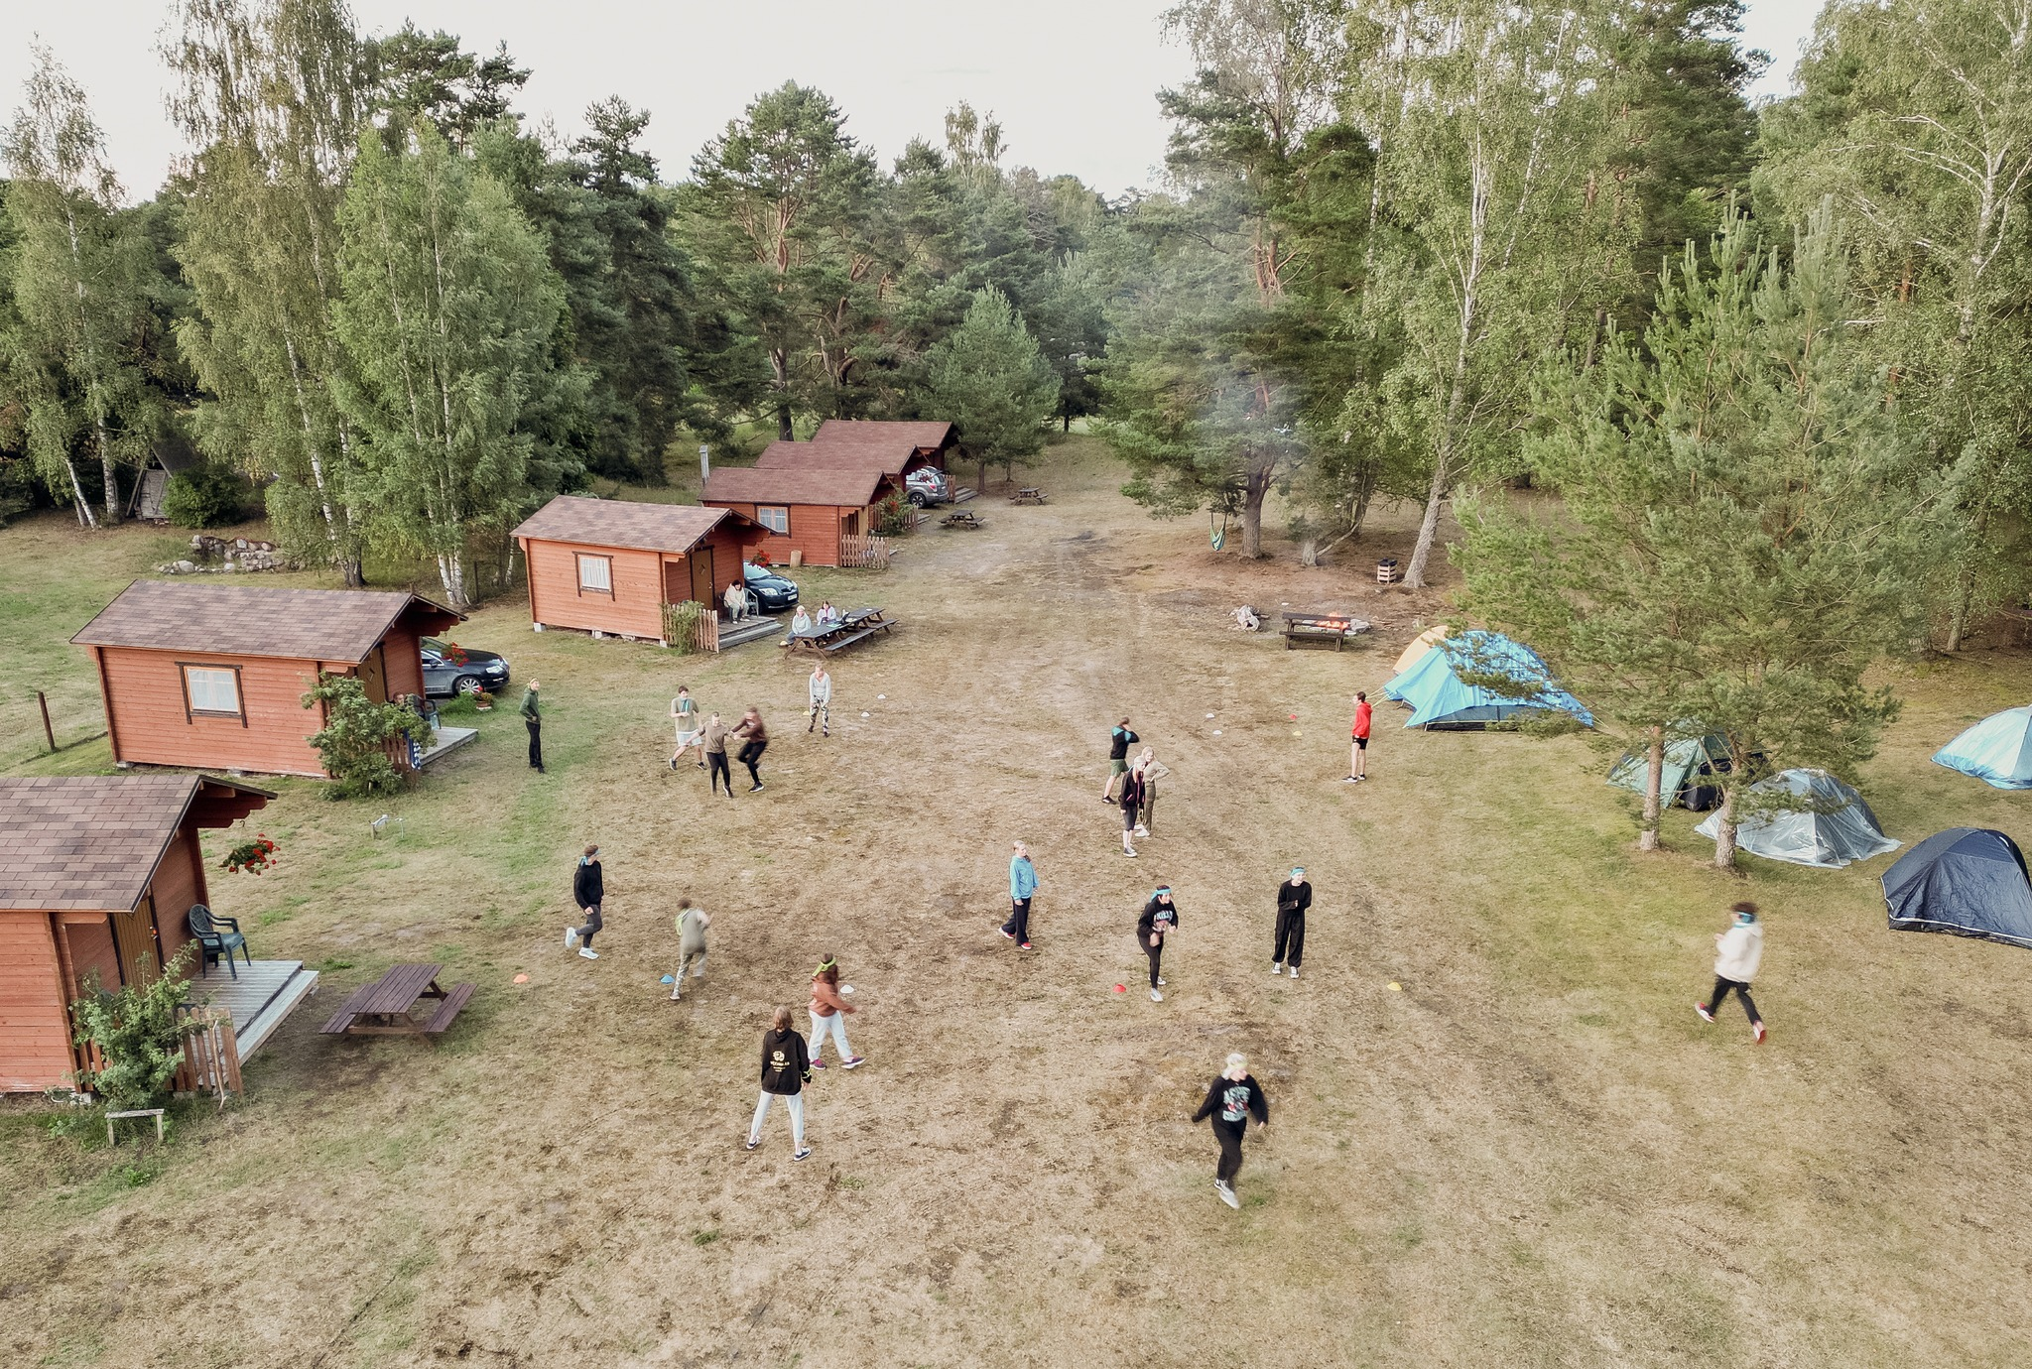
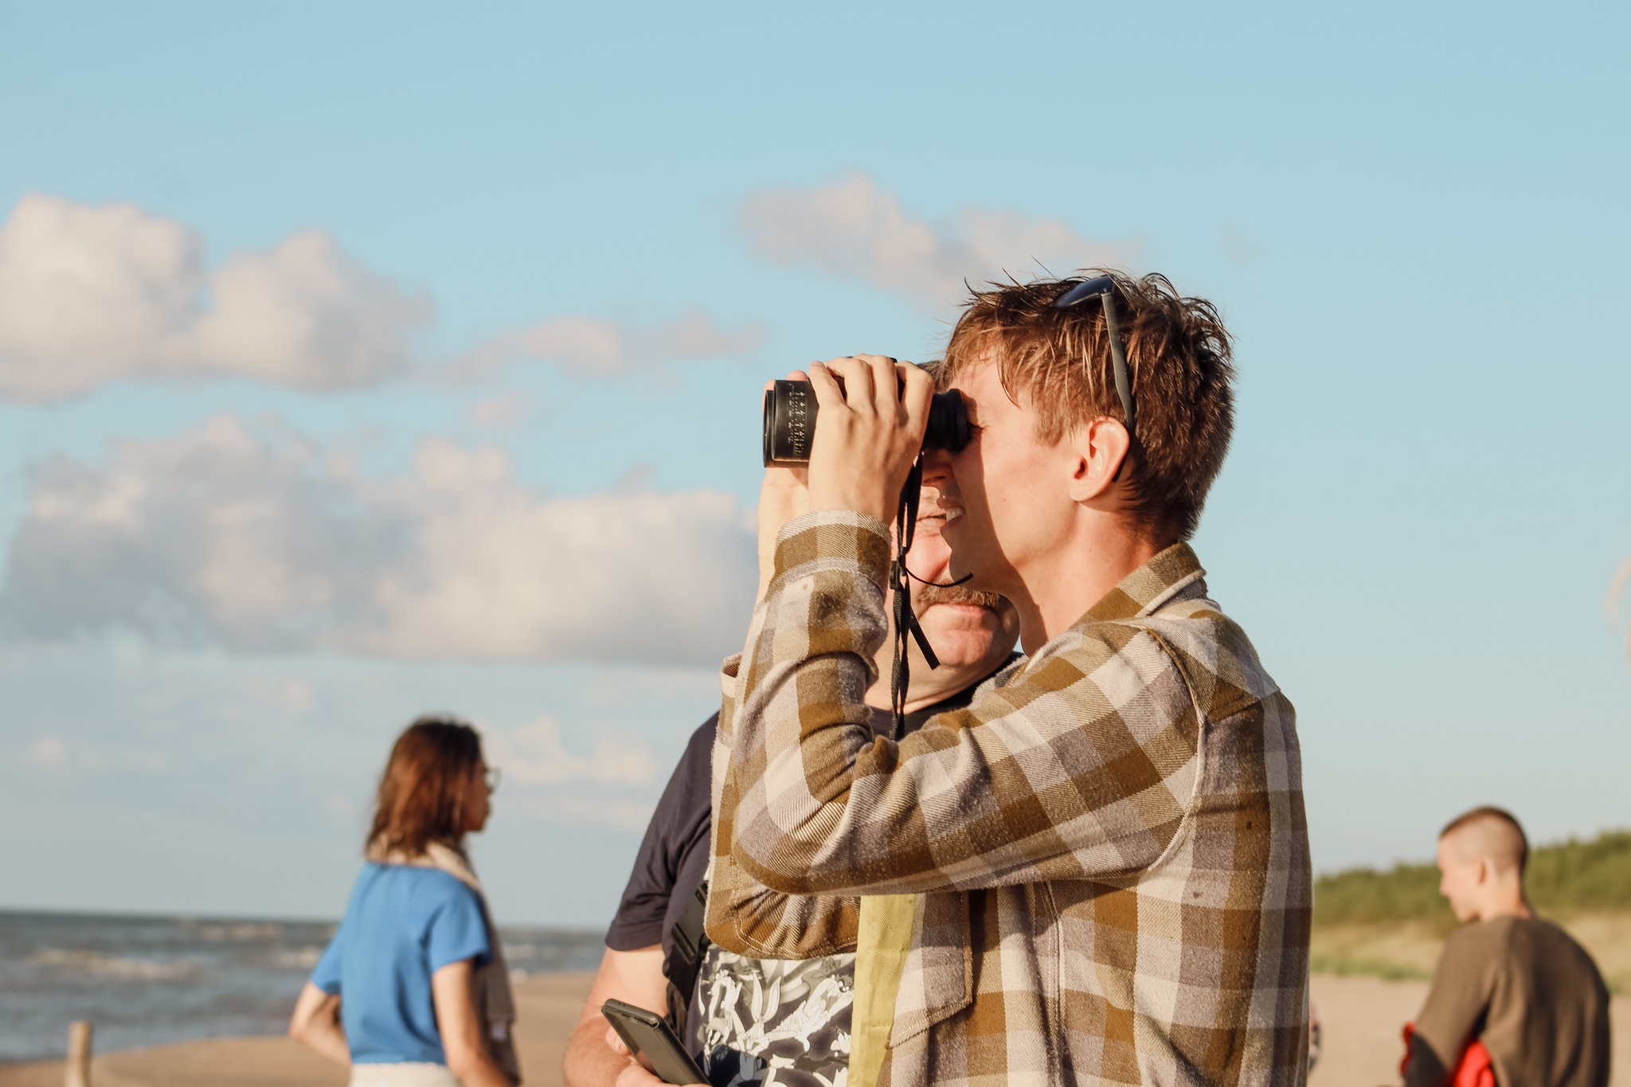
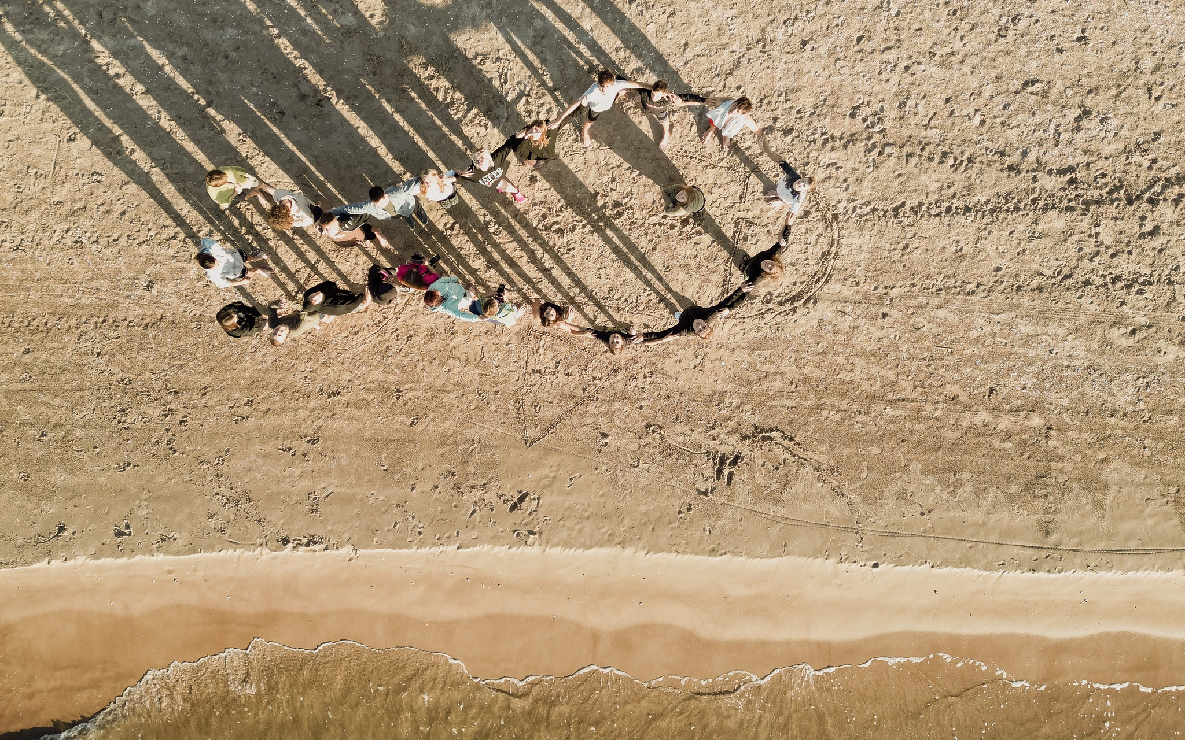
1st day of the camp
On the first day, the participants settled in, pitched their tents and explored the Mazirbe seaside.
The evening was spent in sports activities and conversations by the fire.

Slide 3
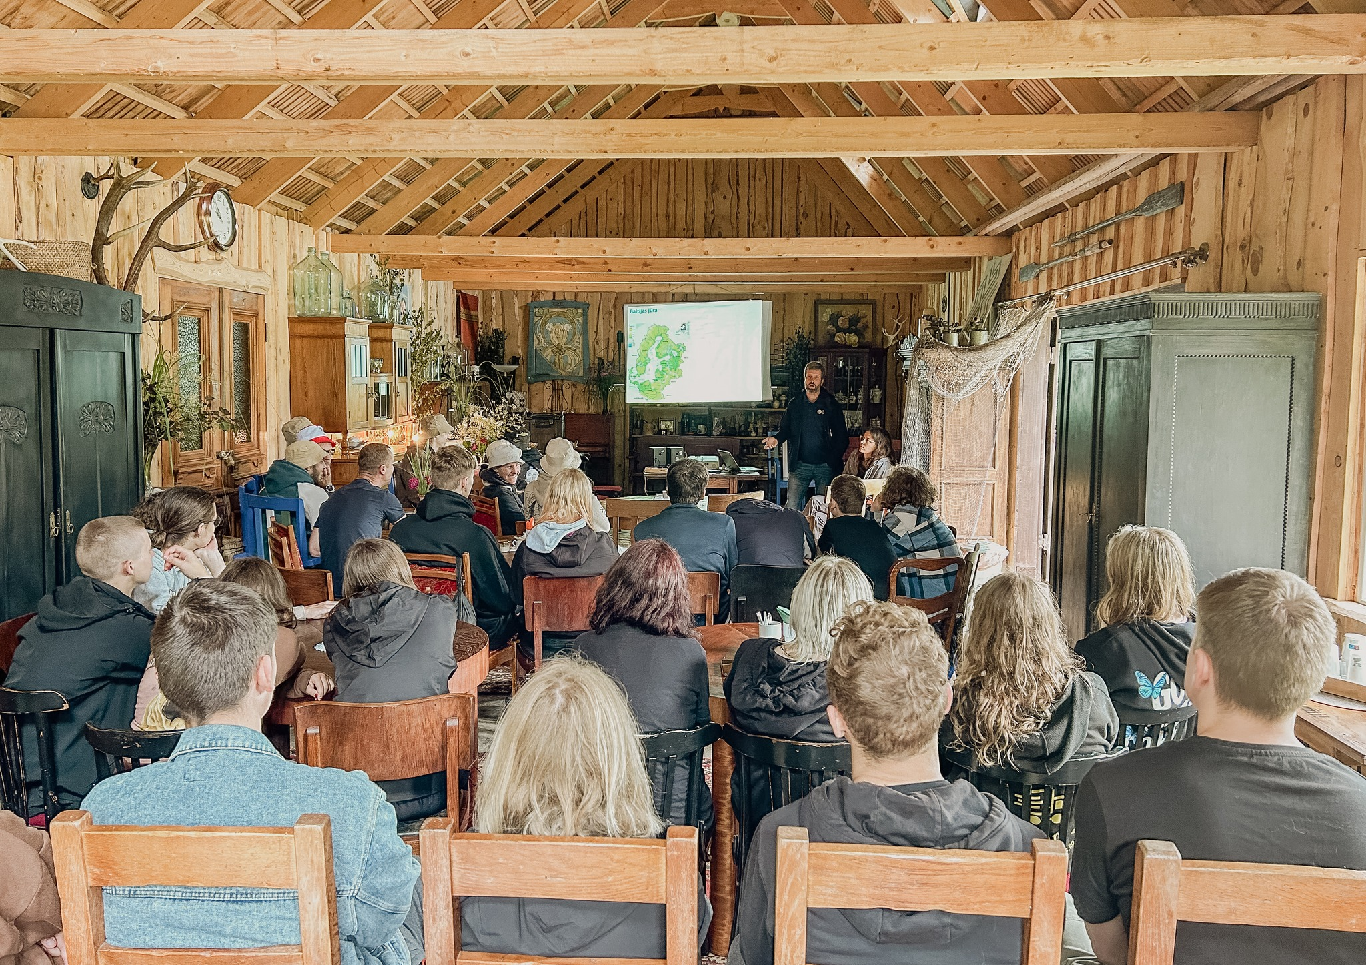
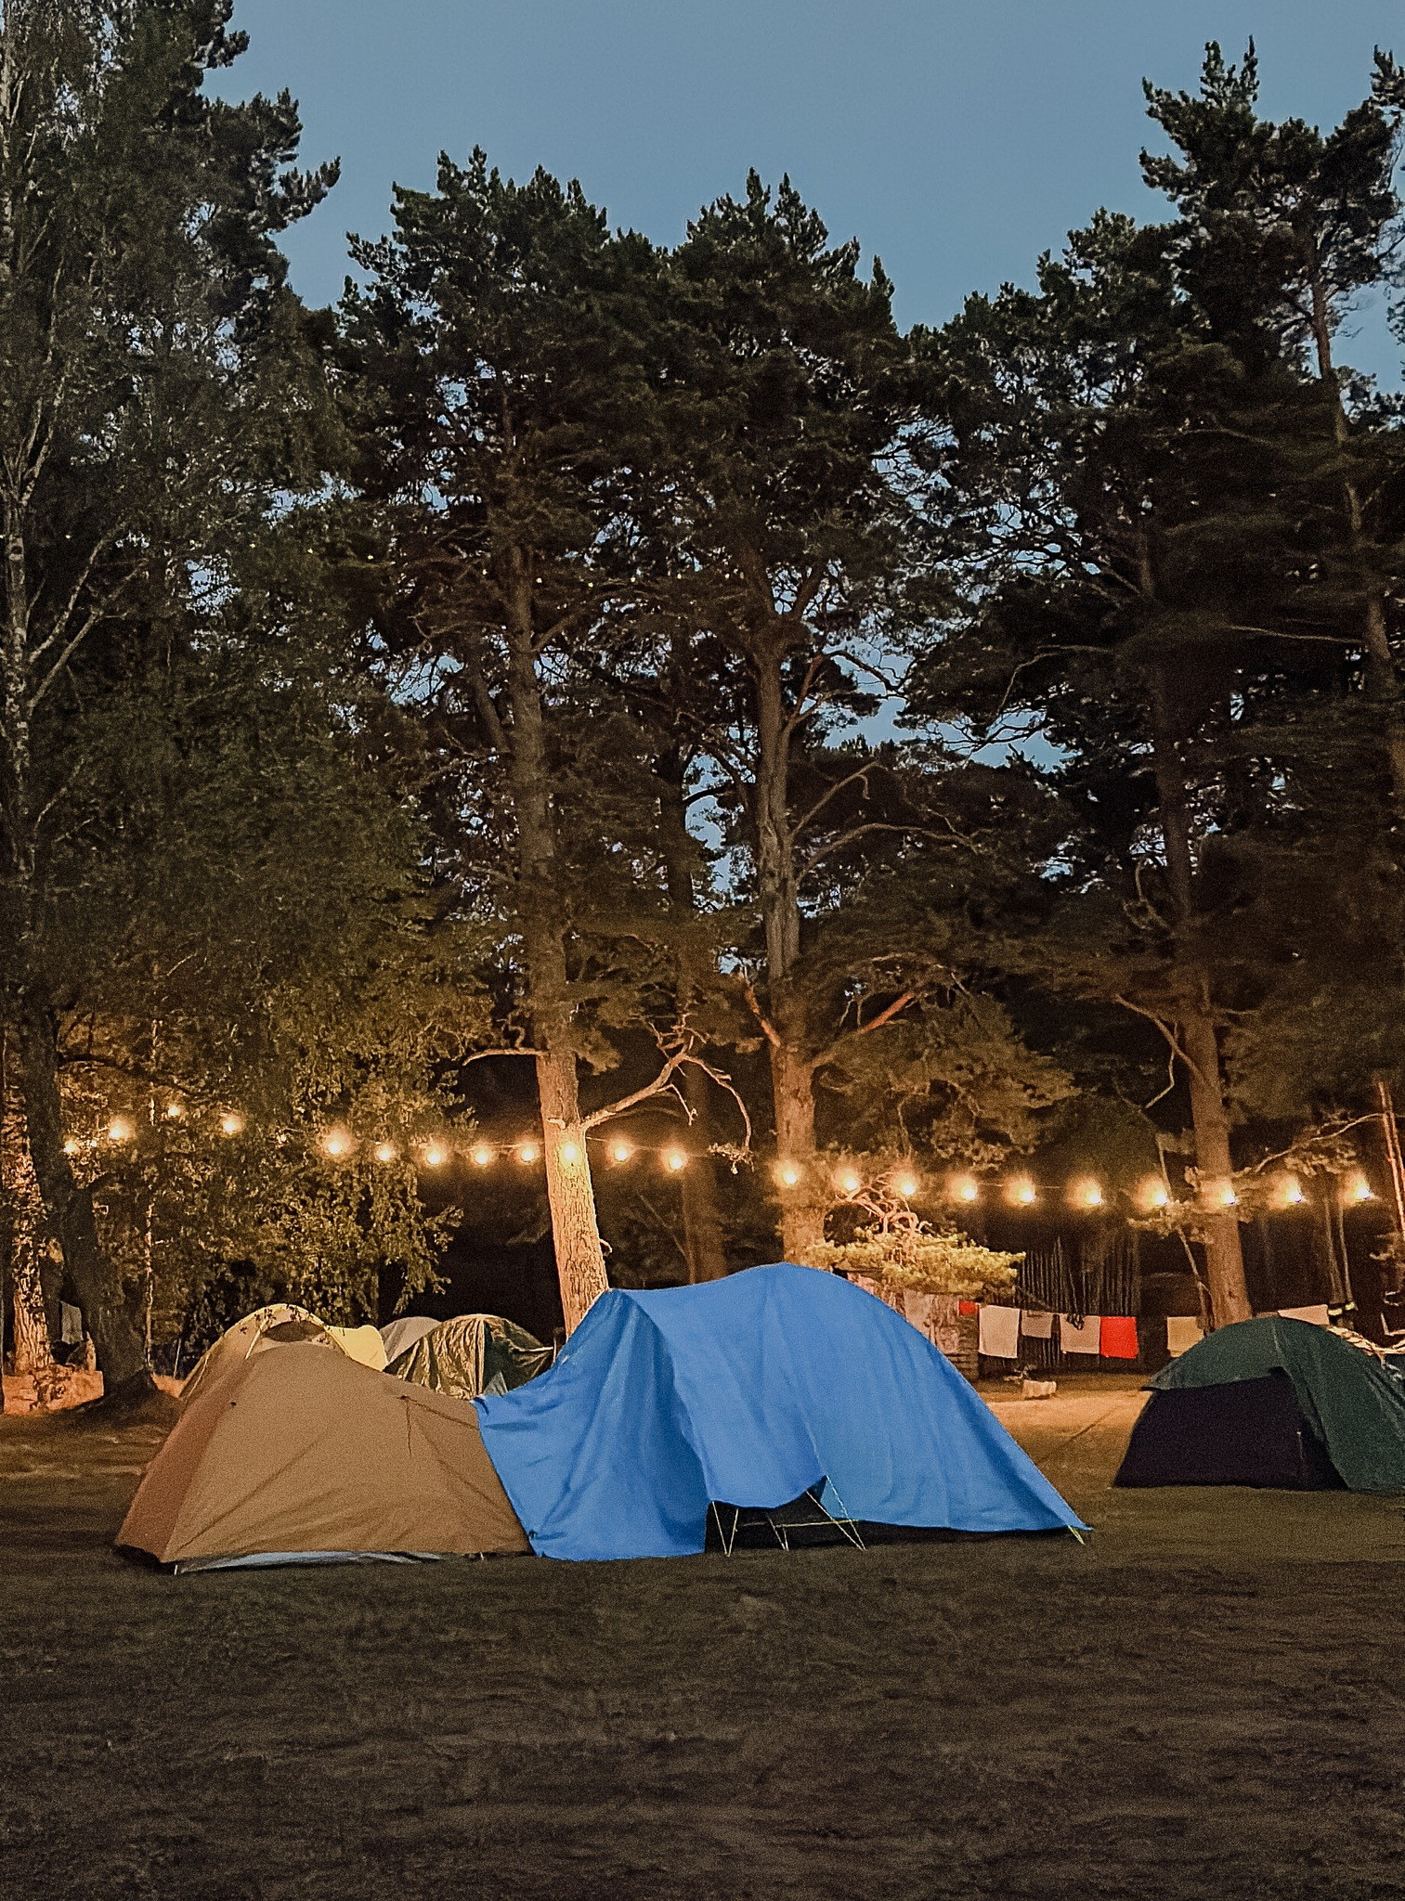
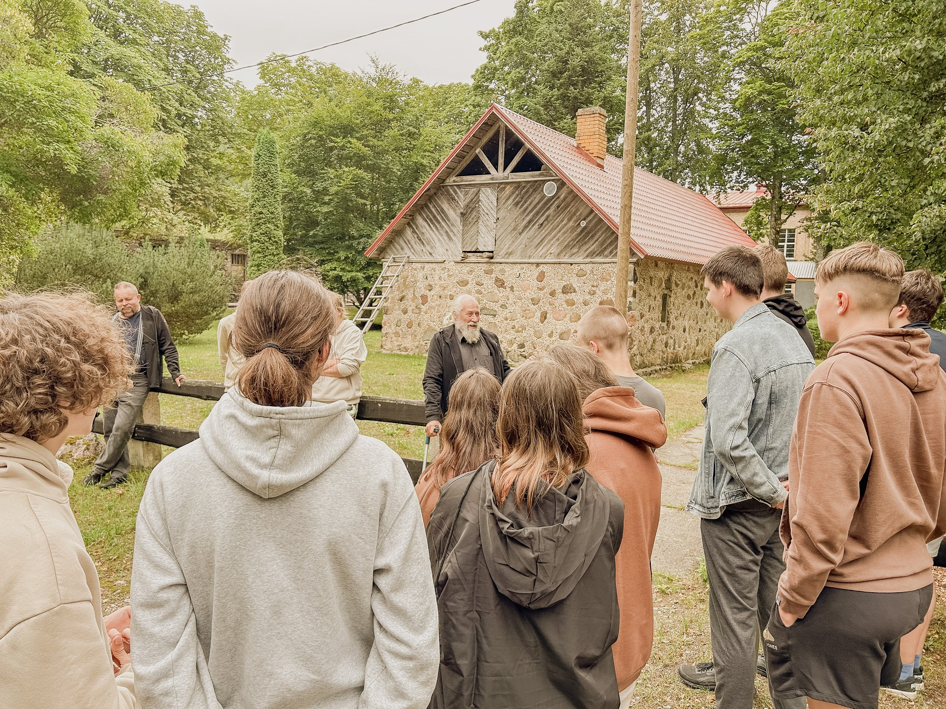
2nd day of the camp
The second day of the camp focused on scientific research with sessions led by BIOR researcher Ivars Putnis on Kolka coast fish communities and herring stock management.
Researcher Rebeka Tetere introduced participants to the flounders found in the Baltic Sea.
In the afternoon, the group attended a lecture by environmental guide Edgars Millers on the Livonian cultural heritage in Mazirbe.

Slide 4
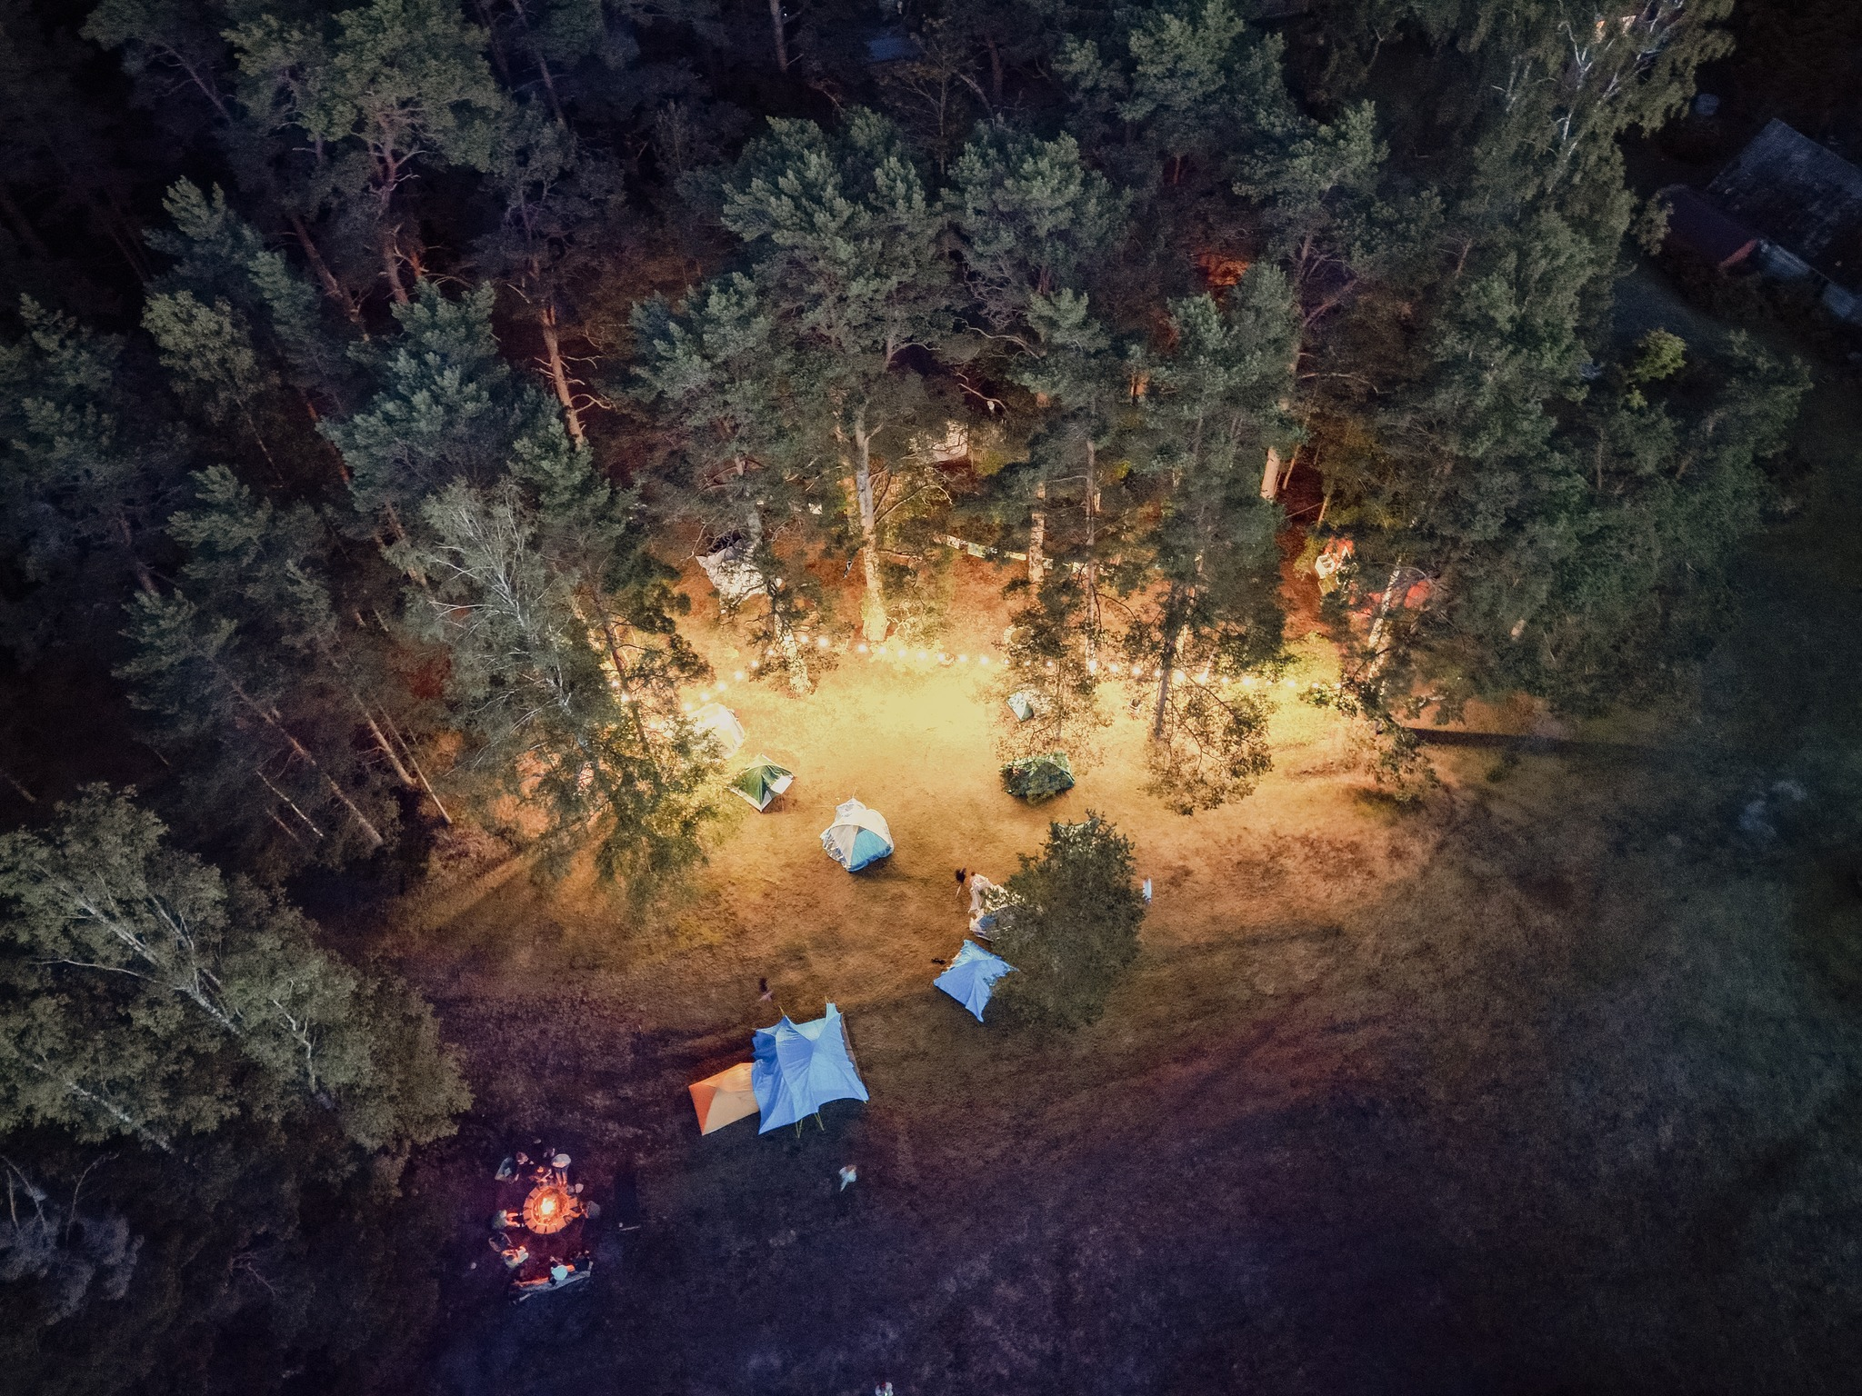
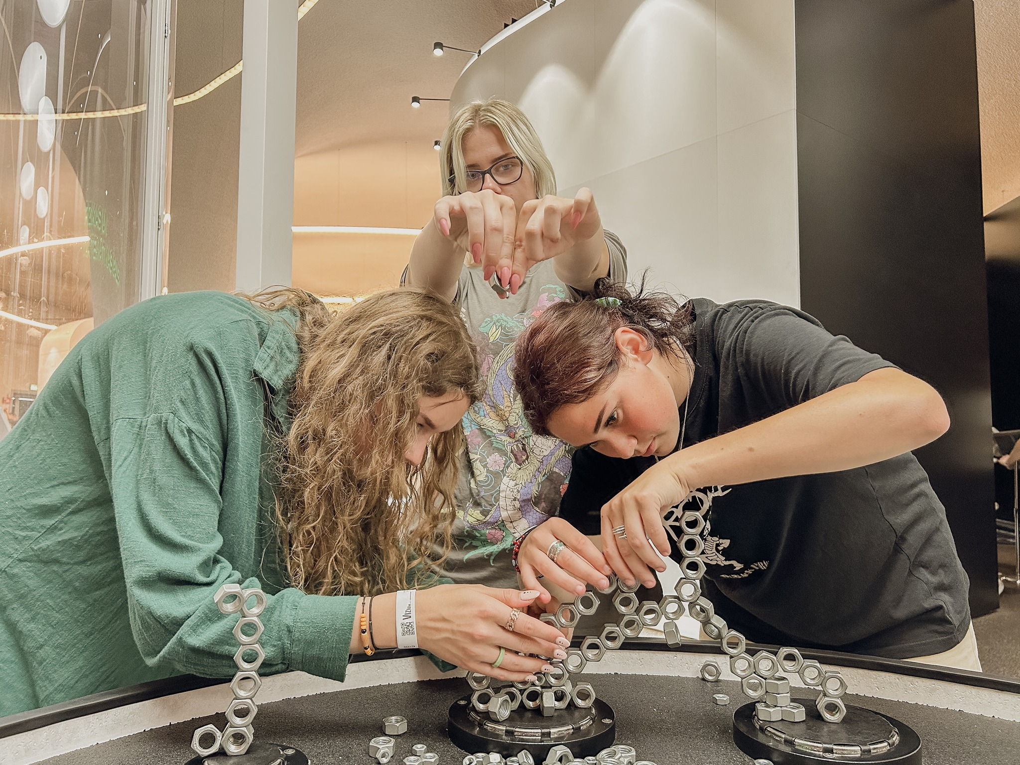
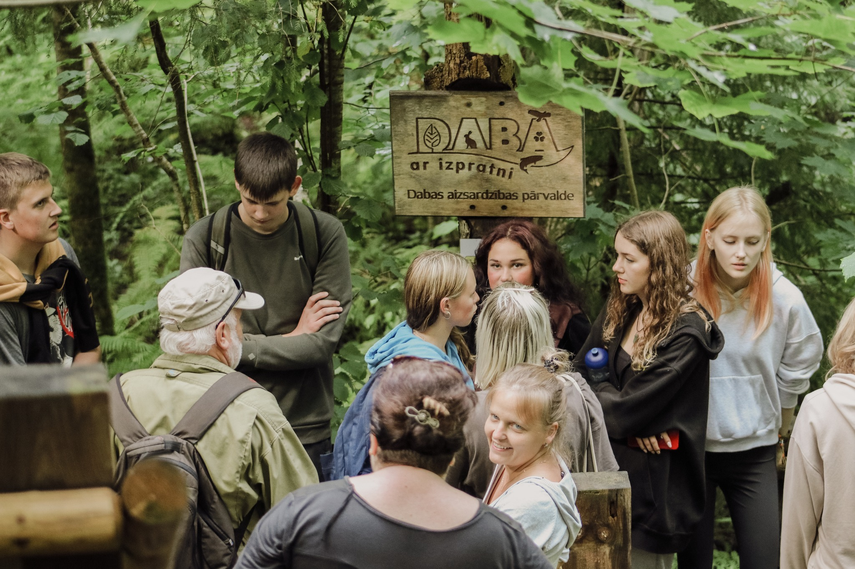
3rd day of the camp
The third day of the camp included a visit to the VIZIUM science center in Ventspils, where participants engaged in seven themed galleries.
The group attended a session on the natural beauty of Slītere's forests and bogs and explored the Slītere lighthouse under the guidance of specialist Vilnis Skuja
.
During the nature trail walk, discussions focused on the interaction between nature, human activities, and climate conditions.

Slide 5
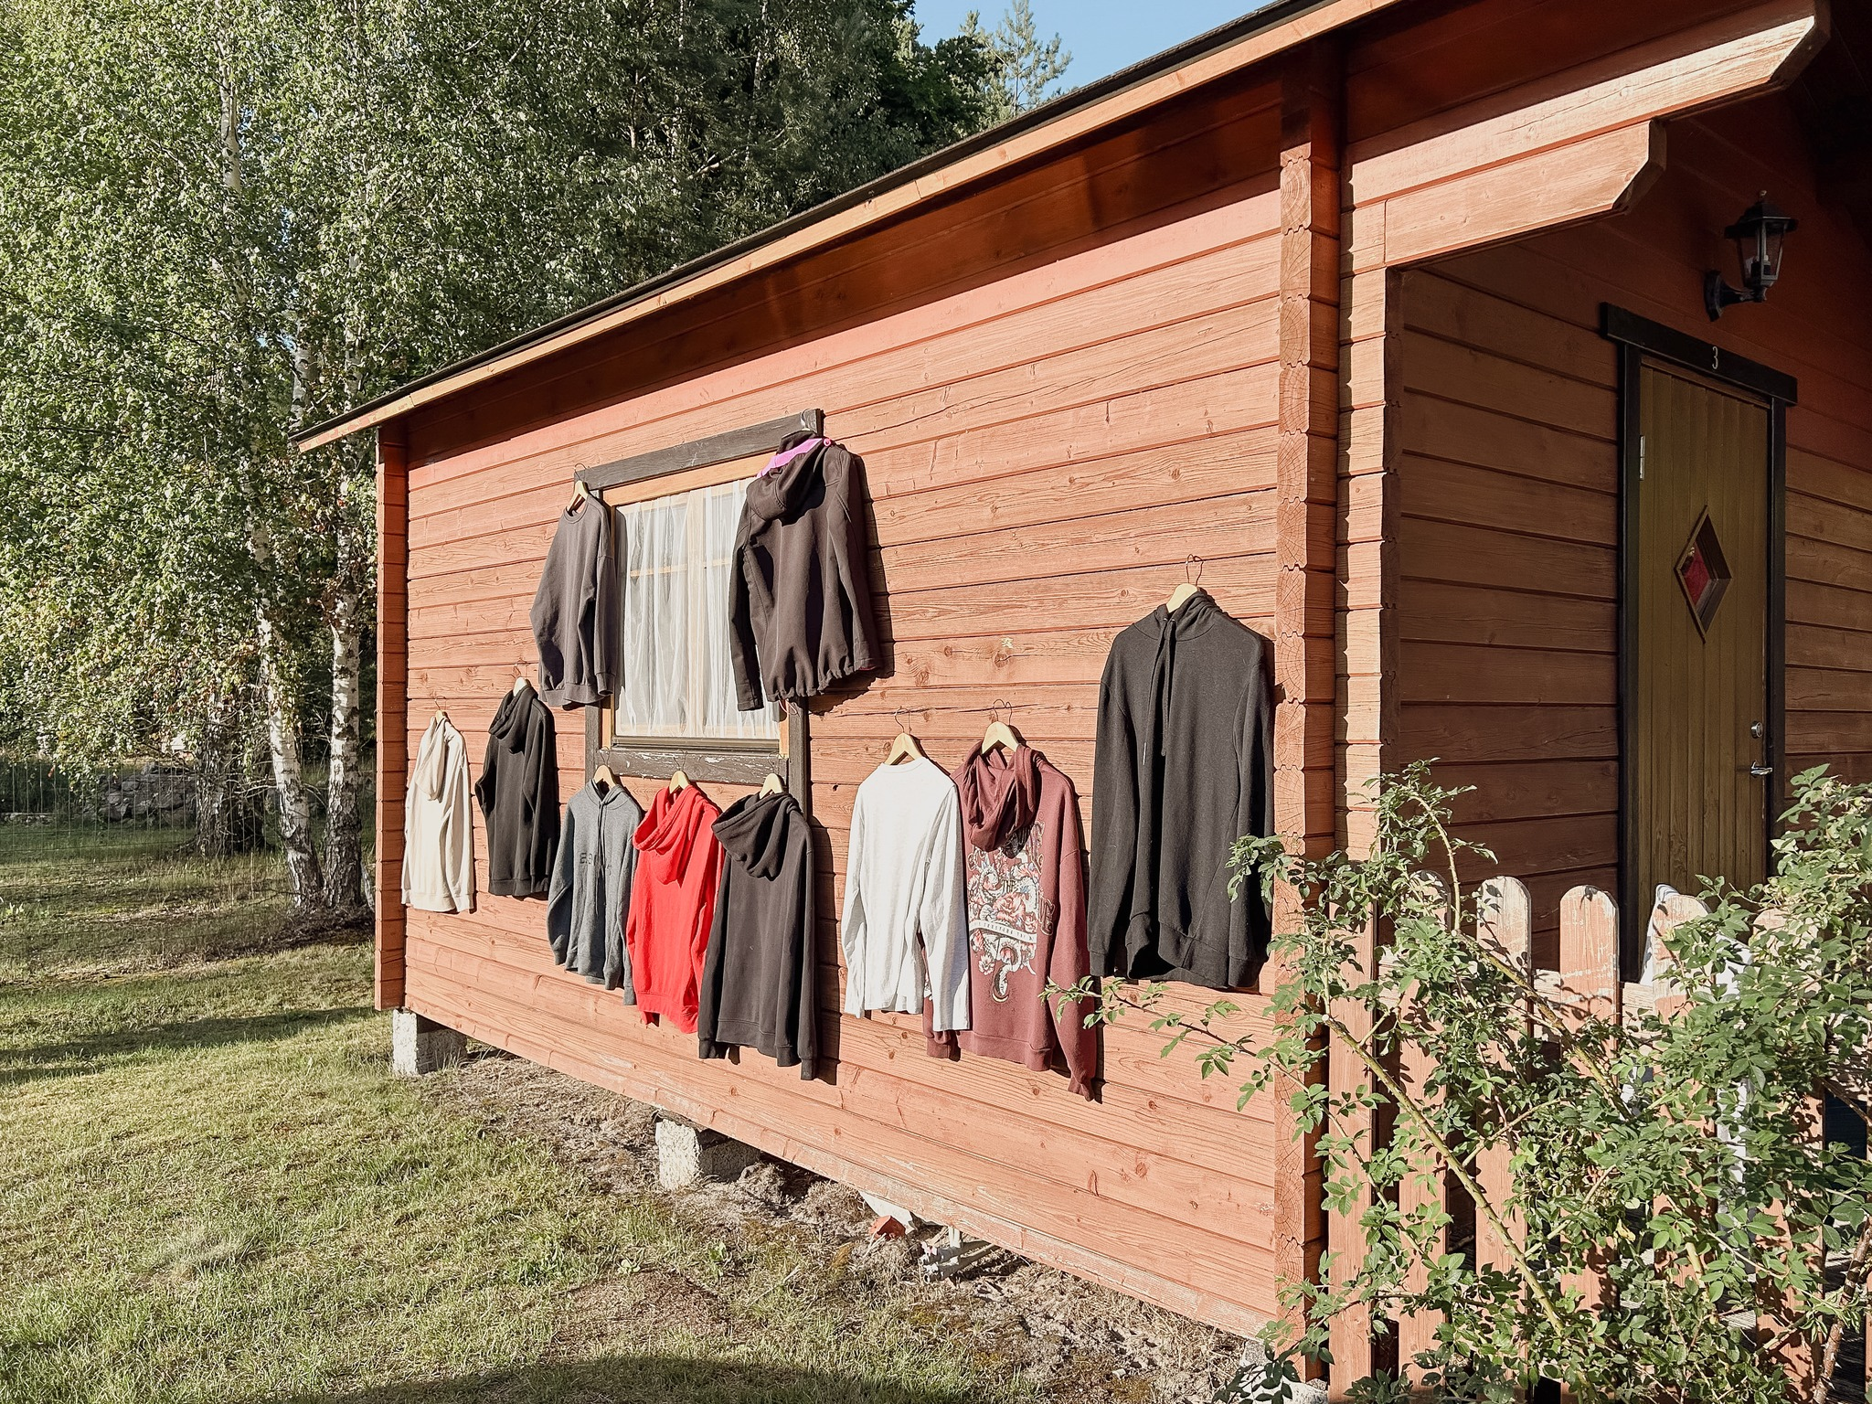
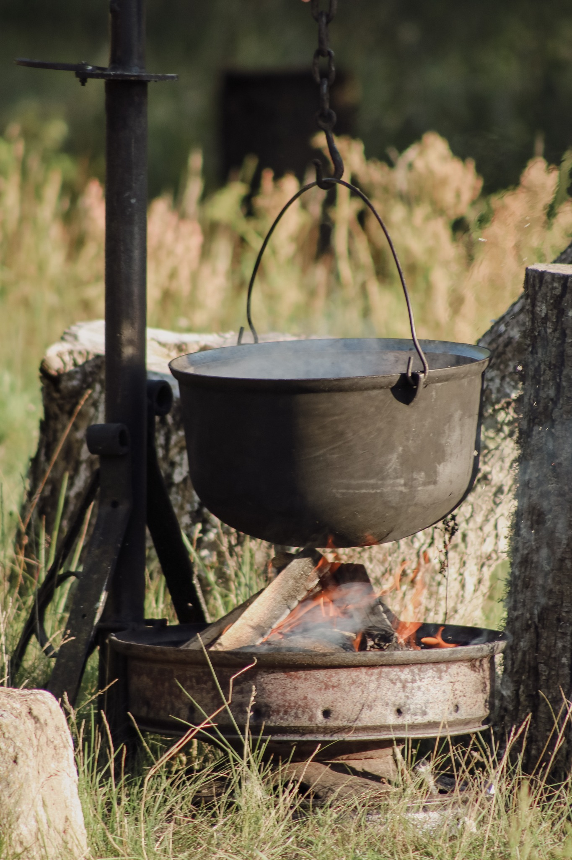
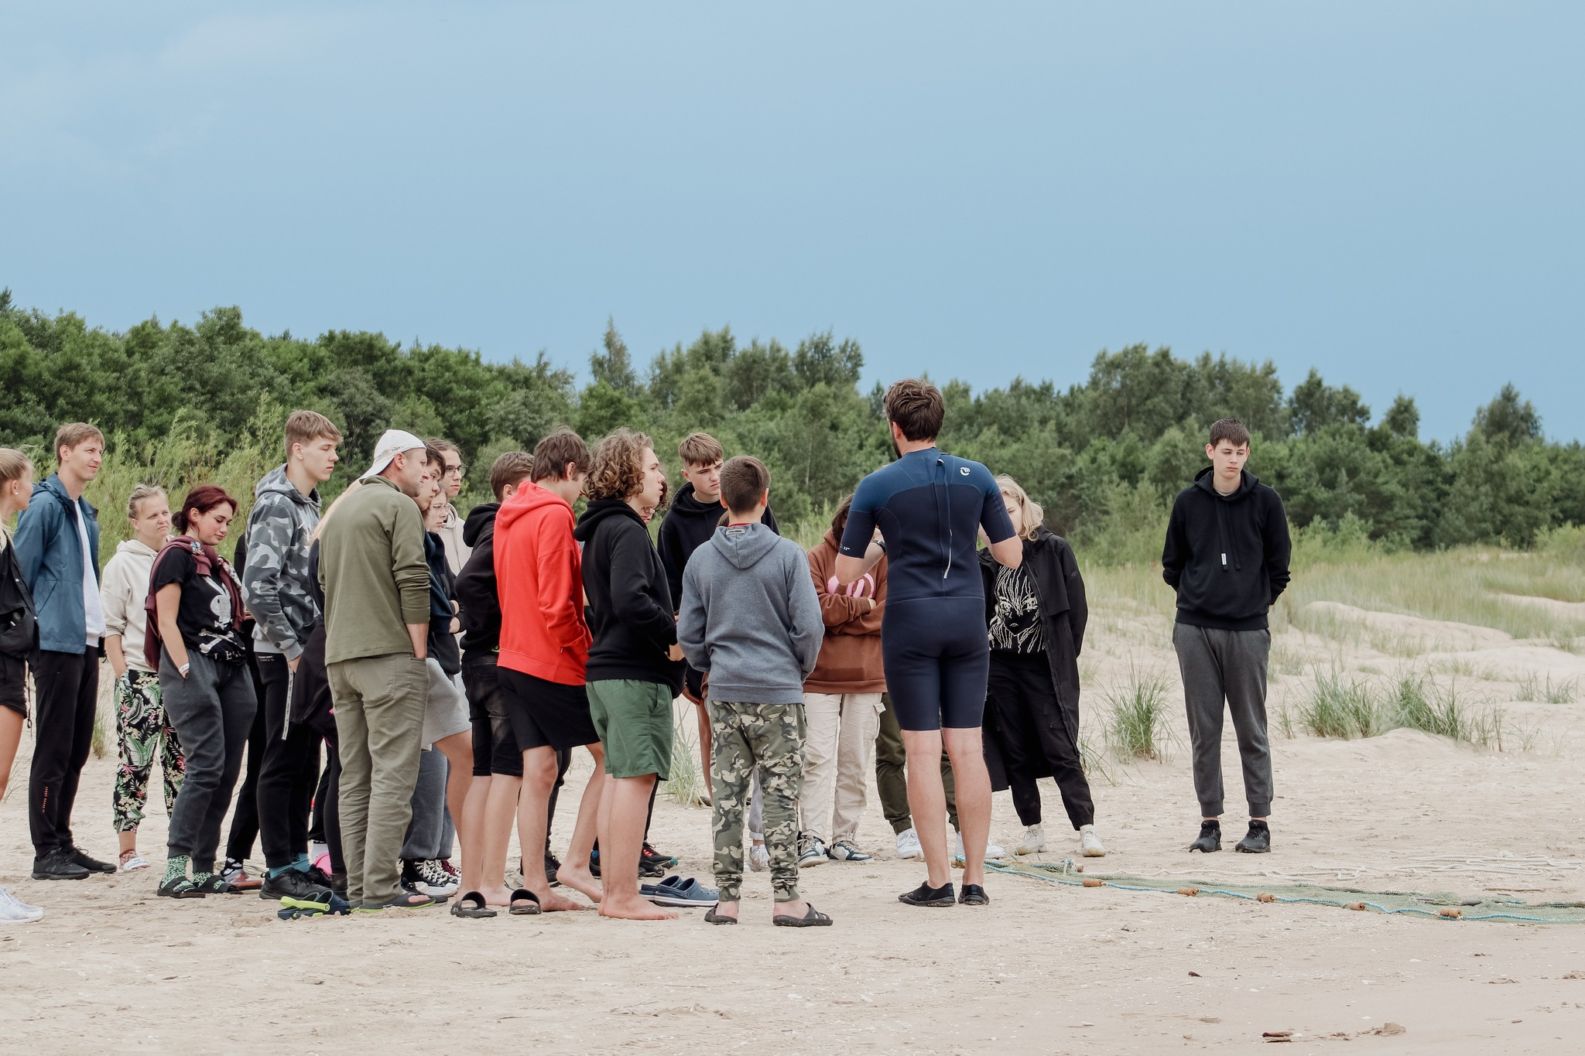
4th day of the camp
On the fourth day, participants surveyed fish fry along the coast with BIOR researchers Kārlis Heimrāts and Raimonds Radzevskis.
Antra Stīpniece introduced the group to various bird species found in the Baltic Sea coastal region.
The afternoon included an orienteering competition and traditional fish soup, celebrating their shared love for nature and creating lasting memories.

