Slide 1
WATER the predominant element in the Netherlands

Slide 2
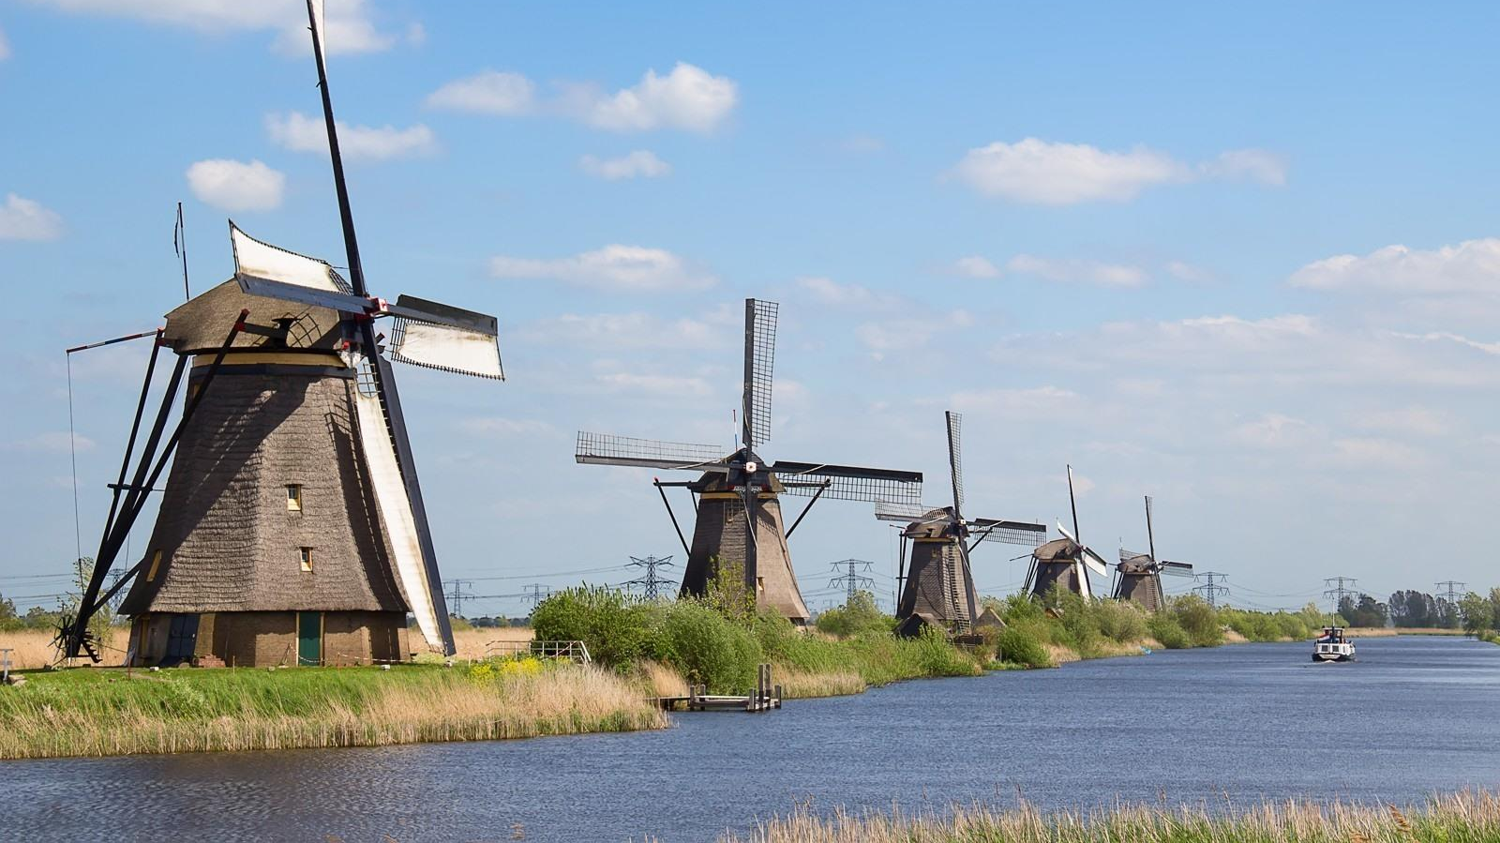
Zuyderzee, a sea no more
The polder stretches to the horizon
It is here where once the waters were.
Where the waves swallowed up ships,
Where the waves washed driftwood ashore,
Where the waves drowned the land.
But now the sea has been contained:
First the surface of the waters smoothed,
Then waters drained and dried the land
Green grass now grows where once the waters were
The polder stretches to the horizon.

Slide 3
What I am here to tell you about is the Dutch and water management. There was water, water everywhere and yet we wanted land.
God created the world, but the Dutch created the Low Countries, the Netherlands, or so they say.
There certainly is some truth in this statement, as at present about one third of the Low Countries are indeed extremely low. Below sea-level to be exact. And that’s where I live: below sea-level.
These low lands were reclaimed in the course of the centuries. It was only through close collaboration and ingenuity that this was achieved.

Slide 4
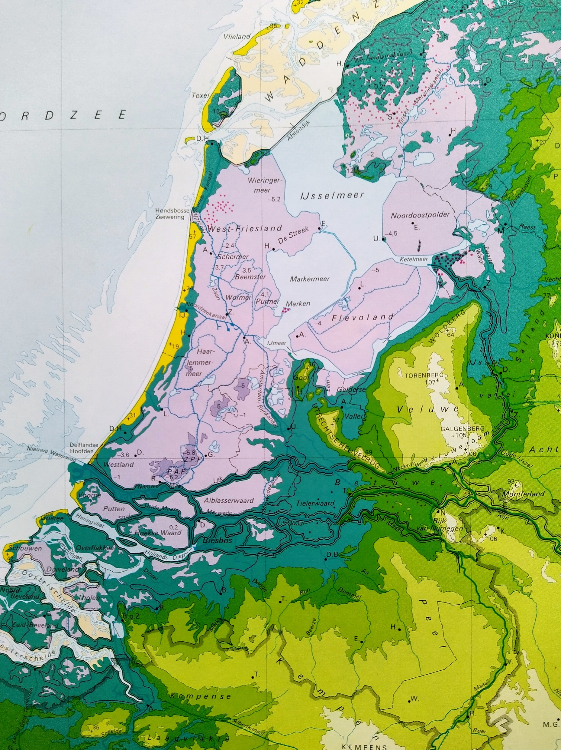
This map illustrates very well that if the sea level rises by 5 meters most of what is now known as the Netherlands will most likely disappear under the waters of the North Sea. The purple colour on the map indicates land below the present sea level, the area in blueish green will be completely inundated by the rising sea.
Amsterdam, Rotterdam, The Hague and Antwerp alike will disappear in the deluge. Perhaps the remains of a few high rise buildings will be silent witnesses of what once was this proud country of the low lands by the sea. Unless of course the Dutch and the Flemish -they are in this together- will find a way to reinforce and heighten their dunes and sea dikes.

Slide 5
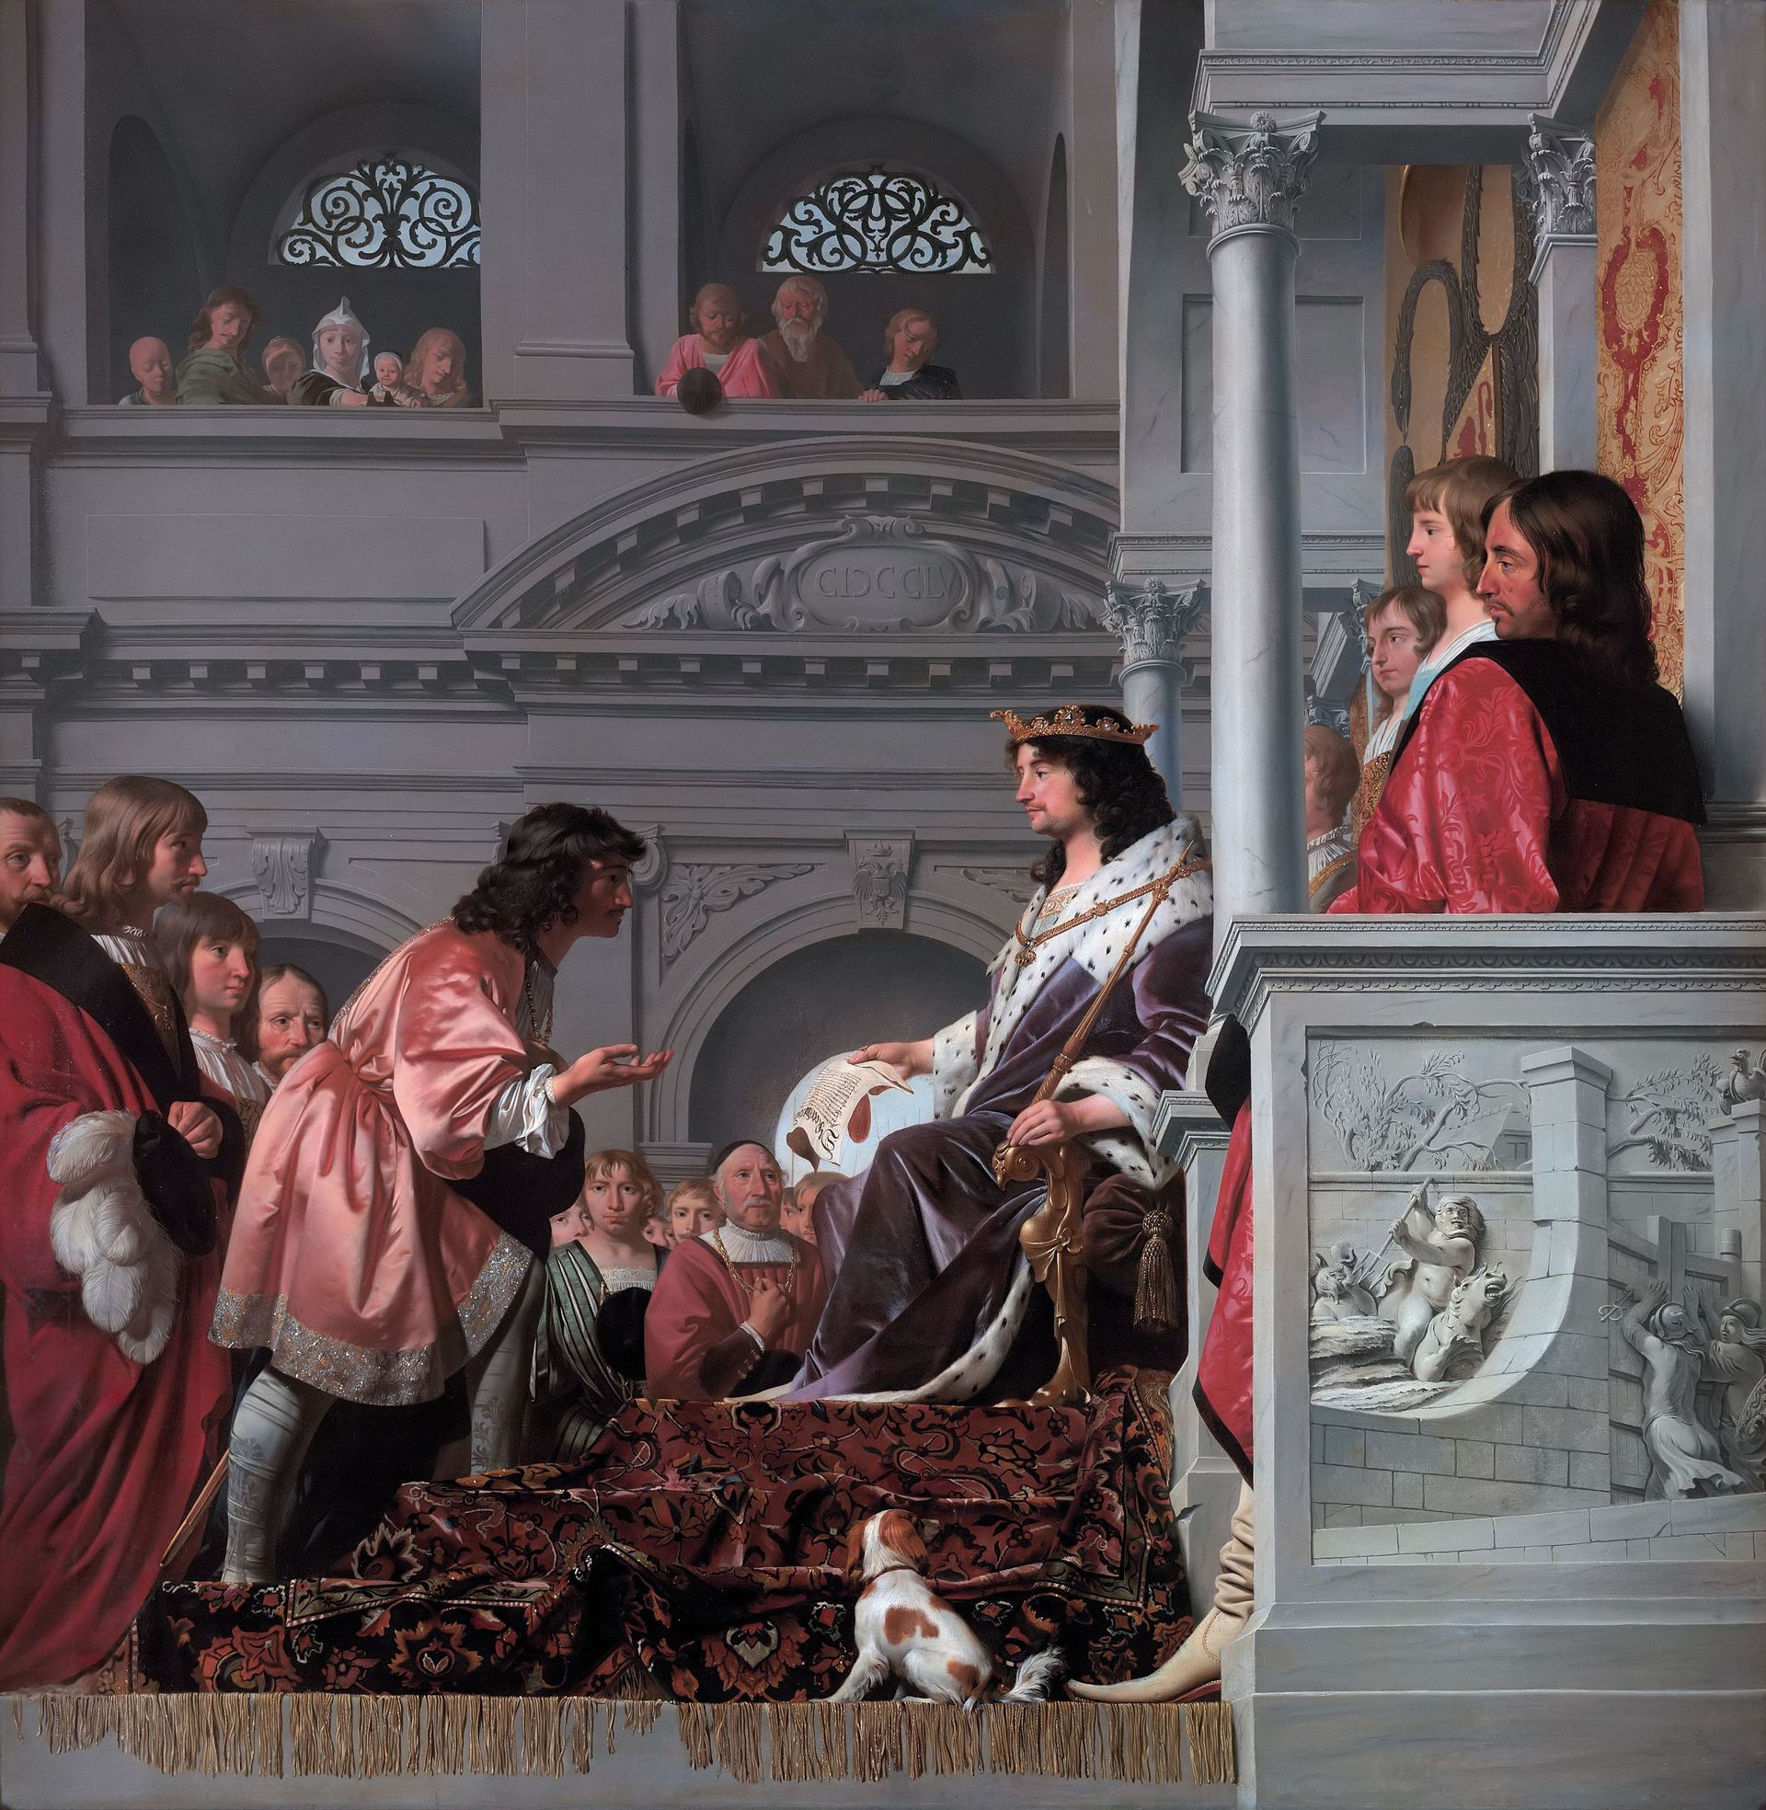
Count William II
As early as in the middle of the 13th Century count William II granted privileges to an organisation that would eventually evolve into the present water authority of the Rhine estuary.

Slide 6
As a consequence of the draining of lowlands and lakes for agricultural purposes, water control became important because farmers needed to keep their lands dry.
This led to the establishment of what we now know as Water Authorities. To the present day these institutions see to it that dikes and water control structures are built and maintained. In the past this was done by those who directly benefited i.e. farmers and landowners.
These people in fact formed the the earliest democratic institutions in the Netherlands, if not in Europe. They were the ones that built windmills whose function it was to pump the water out of their polders.
These present day tourist attractions were, and sometimes still are, the most indispensable pumping machinery.

Slide 7
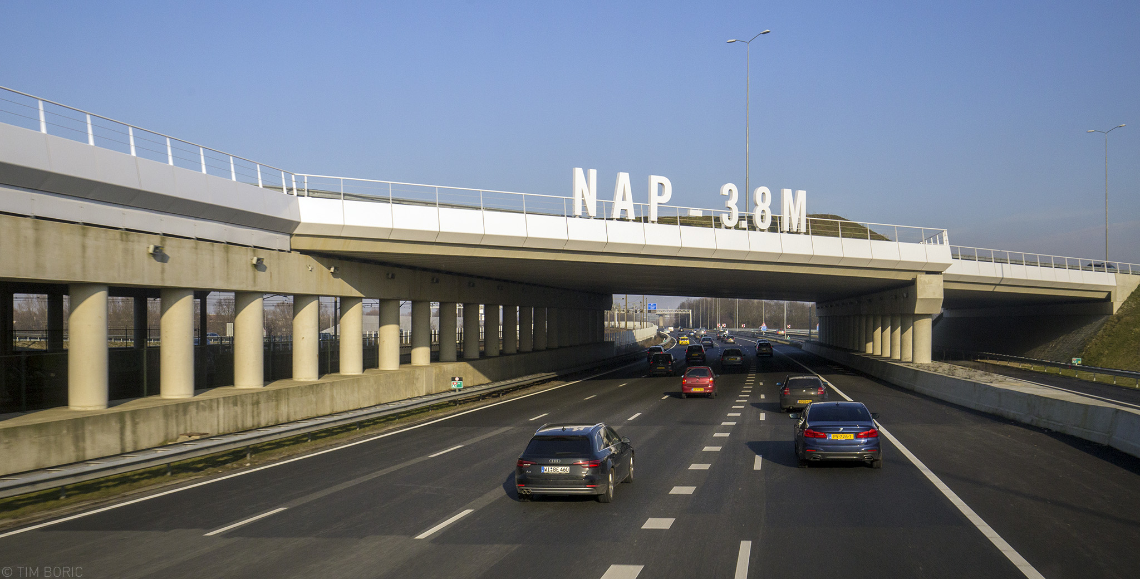
Illustrating the position of Schiphol (N.A.P = Sea level).
This means, the airport is situated 3.8 meter UNDER sea level!

Slide 8
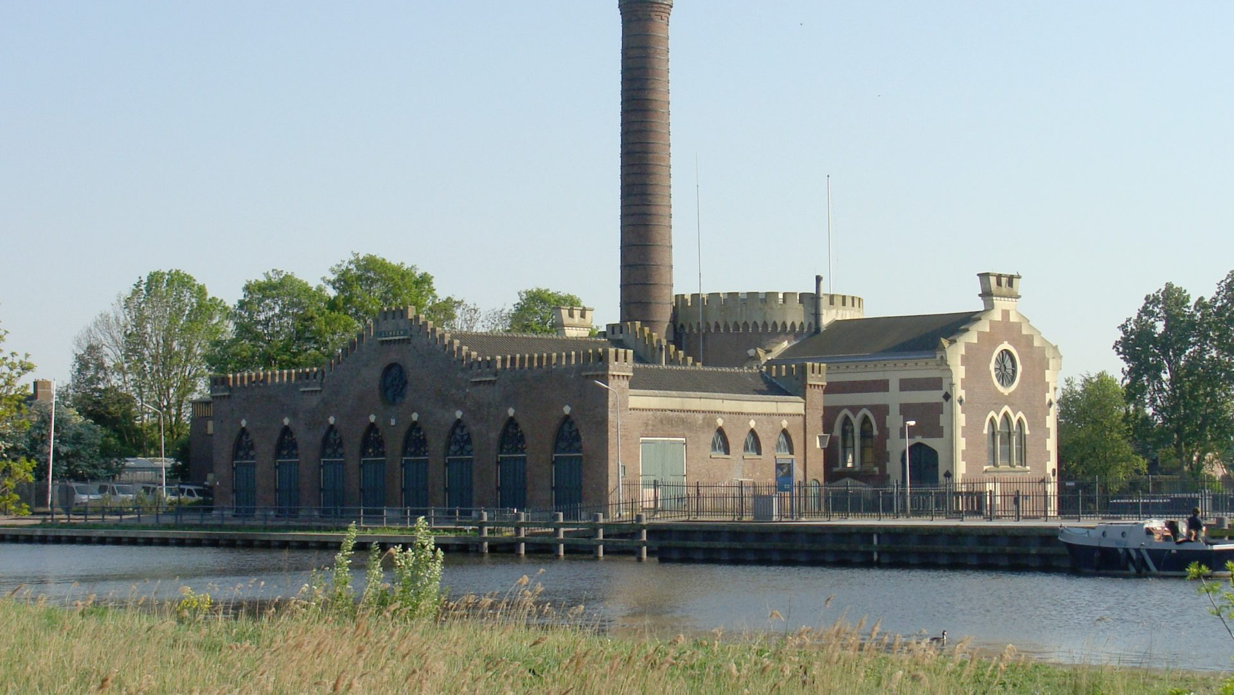
Further information in the accompanying text! =>

