Slide 1
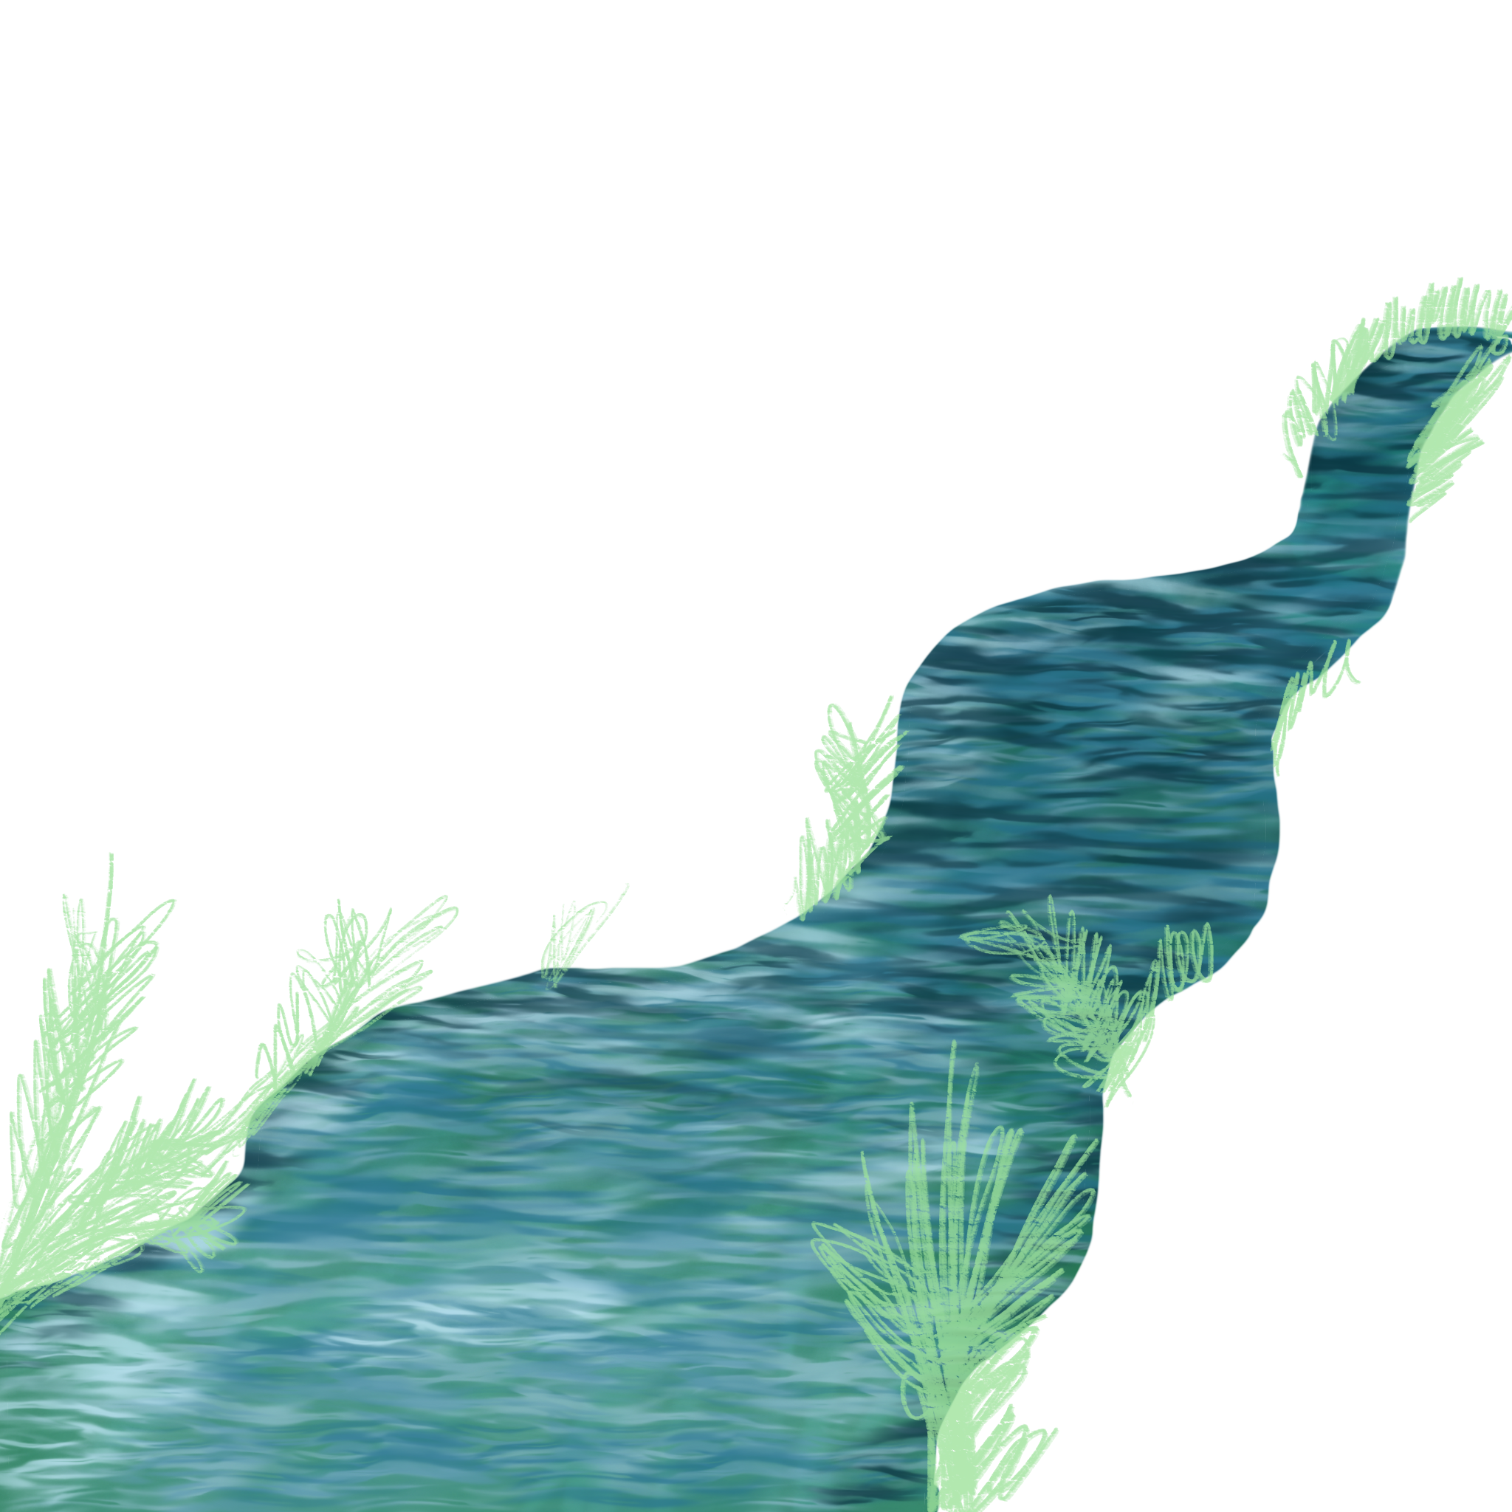
LaGe
Landschaft und Gesellschaft -
unser Leben geprägt durch Wasser
Landscape and society – our lives shaped by water
Homepage: lage.westfaelisches.forum.de

Slide 2
Koordinator:
Westfälisches Forum für Kultur und Bildung e.V.
Partner:
Belgien: Sambucusforum
Irland: Muintearas
Lettland: Oskar Kalpaks Liepaja Secondary School Nr. 15
LaGe

Slide 3
Hintergrund
Background
Klimaentwicklung und Naturschutz sind wichtige Themen
Climate development and nature conservation are important issues
Die Prägung unserer Städte und Regionen ist interessant
The character of our cities and regions is interesting
Paderborn möchte das Europäische Kulturerbesiegel beantragen
Paderborn would like to apply for the European Heritage Label

Slide 4
Diskussion:
Discussion:
Erste Vorschläge für die Website
First proposals for the website
Kooperation mit der Stadt Paderborn
Cooperation with the city of Paderborn
Beteiligung an der Europawoche 2023
Participation in the Europe week 2023
Nächstes Treffen in Belgien
Next meeting in Belgium

Slide 5
1. Competition:
Make a 3 minutes video => „water impressions“
Deadline: 01.11.22
Nächste Aufgaben:
Next tasks:
2a. Task for All Partners:
On the second page of the homepage each partner shall give some information about the own „water“: explain the region, the sea, the river, the ocean – just some geographic details…
Deadline: 01.11.22
2b. Comments:
Once this information is uploaded, each partner should add short comments - to show the European interaction!
The impulse questions follow on the next slide!

Slide 6
Kurze Kommentare:
Short Comments:
Was war eindrucksvoll?
Was ist spezifisch nur für diesen Ort?
Was kann genutzt, adaptiert werden?
What was impressive?
What is specific only to this place?
What can be used, adapted?

Slide 7
Water and economic aspects
Weitere Aspekte:
Further aspects:
Fundamental rights of water…..
Comparision of the situation in the countries: drinking water for free?
Collection of terms, names and phrases - inspired by water
Songs and poems on the topic of water

Slide 8
1. Another competition in spring: Sounds of water
Ausblick:
Perspective:
2. Poems about water:
Two nice poems in alle mother tangues + translation into English or German
3. Benefits and harms of water
4. Paintings and art photos concerning all kind of water

Slide 9
Geschichten:
Stories:
Telling about Development and Changes
(in a short video taped interview)
Liepaja and hinterland
Galway Bay and hinterland
Mecheln and hinterland
Paderborn and hinterland

Slide 10
Weitere Planung:
Further planning
Later we will consider if we will:
=> create a timeline with important events
=> analyse development steps in the past

Slide 11
1. Competition: „Video“ =>
01.11.2022
2. Info about each parter =>
01.11.2022
3. Virtuell meeting with the teams => 17.11.2022, 4 p.m. (German time)
4. Meeting in Belgium =>
End of February 2023
5. Conference in Paderborn =>
04.05.-07.05.2023
Nächste Termine
Next appointments:

