Slide 1
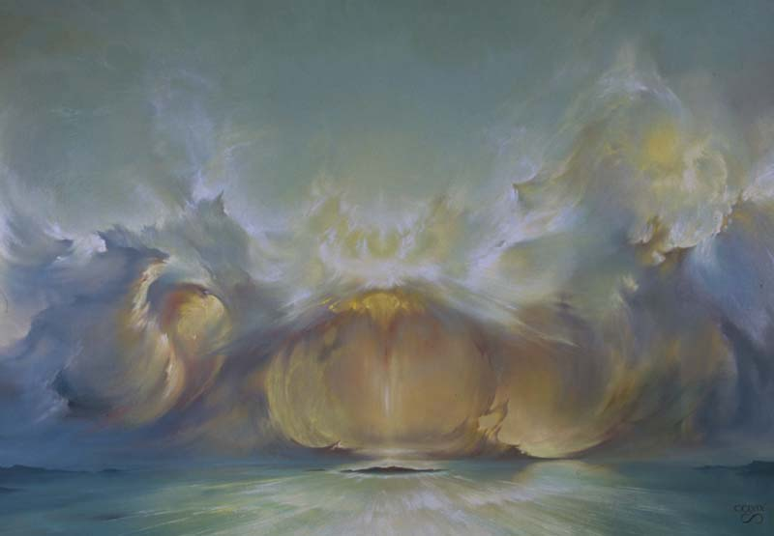
Landscape and society - shaped by water
Rivers and seas determine our lives

Slide 2
The fascination of water

Slide 3
Water is a phenomenon – with many contradictory aspects
Water makes our planet habitable
Water gives life
Water carries us through the day
Water cleans, refreshes and relaxes us
BUT
Water is an elemental force
Water can destroy
Water can kill
Water can make an area uninhabitable

Slide 4
The importance of water for society
WATER
Physics
Food
Transport
Climate
Chemistry
Leisure
Textile

Slide 5
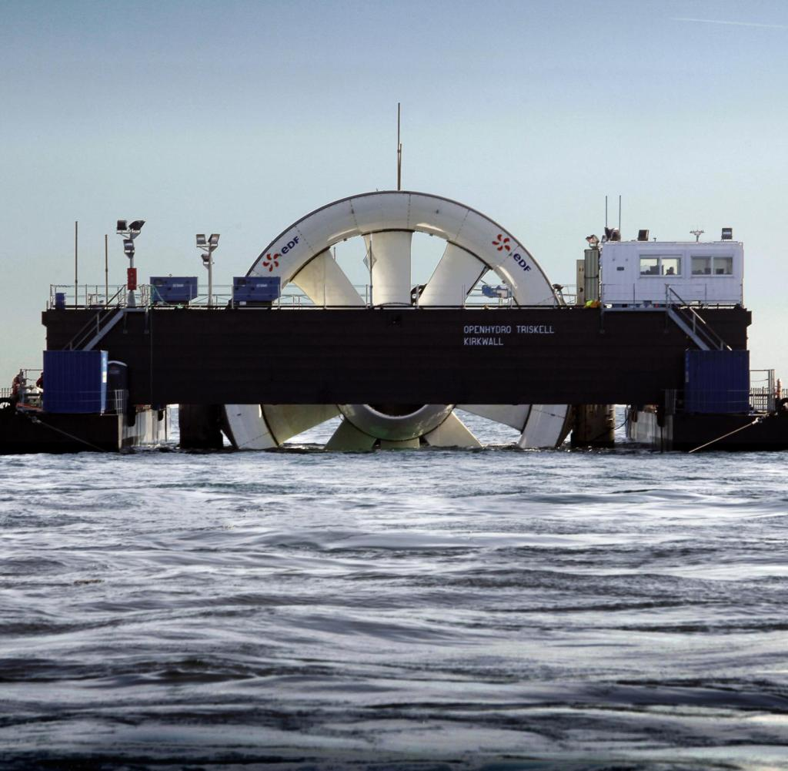
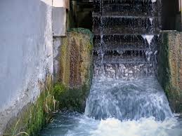
Physics
WATER
Physics
Food
Transport
Klimate
Chemistry
Leisure
Textile

Slide 6
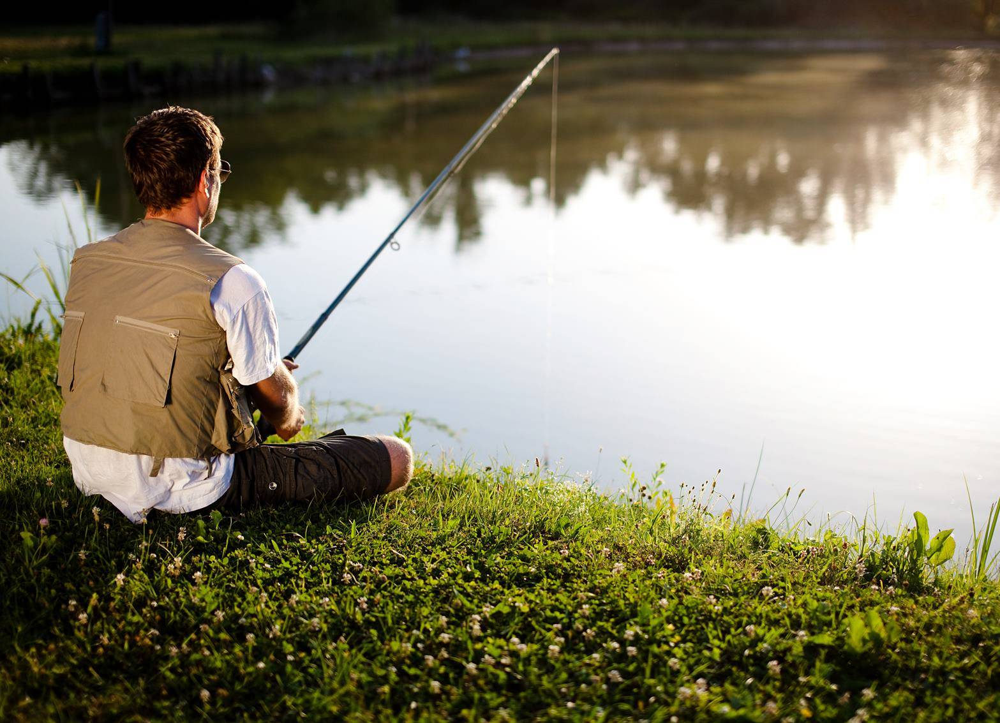
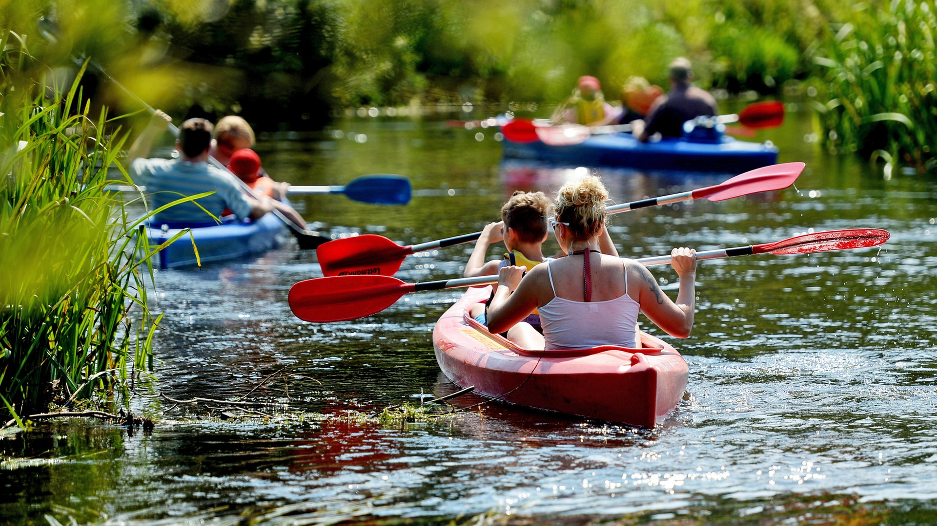
Leisure
WATER
Physics
Food
Transport
Klimate
Chemistry
Leisure
Textile

Slide 7
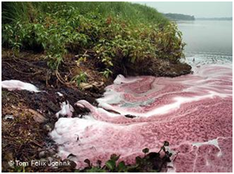
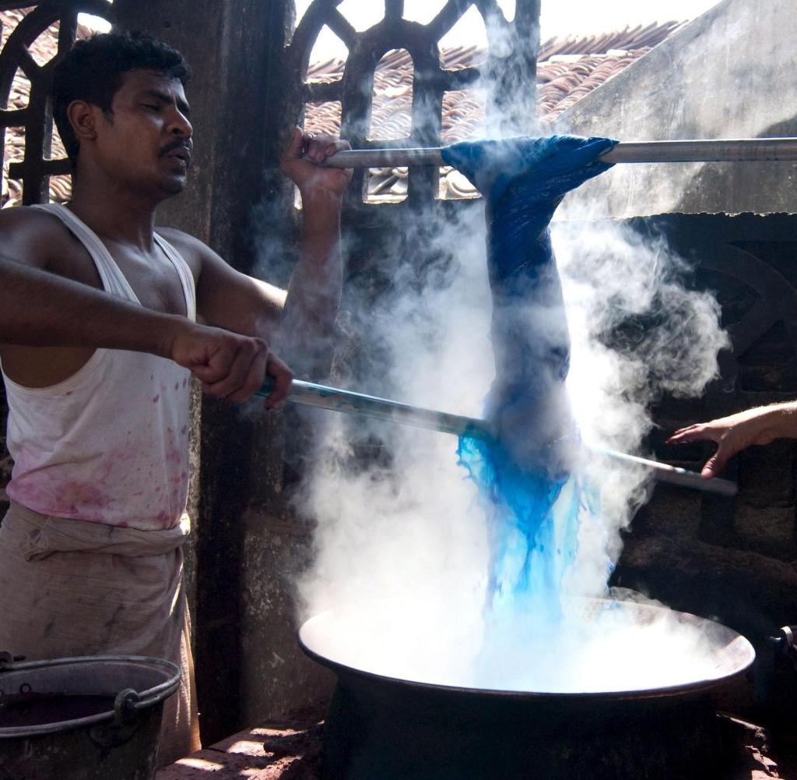
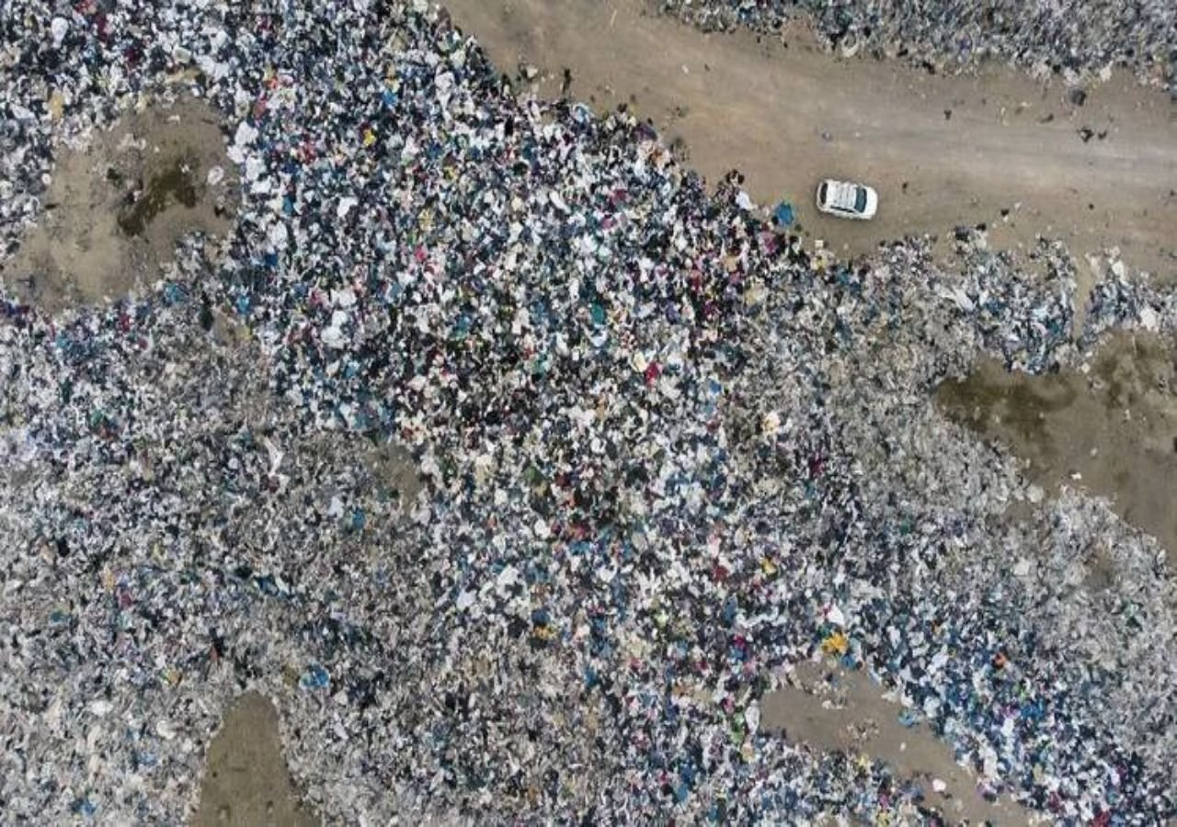
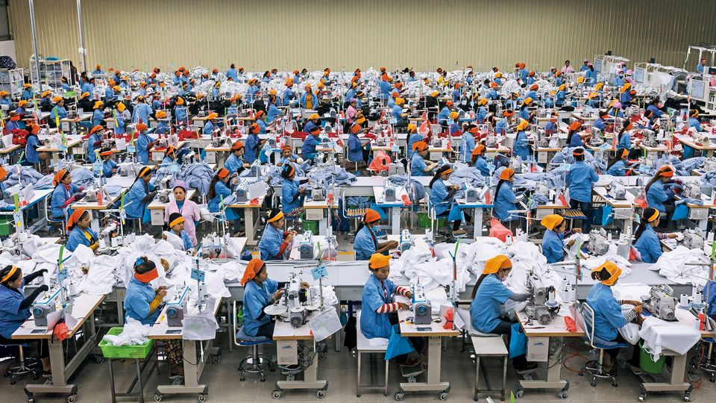
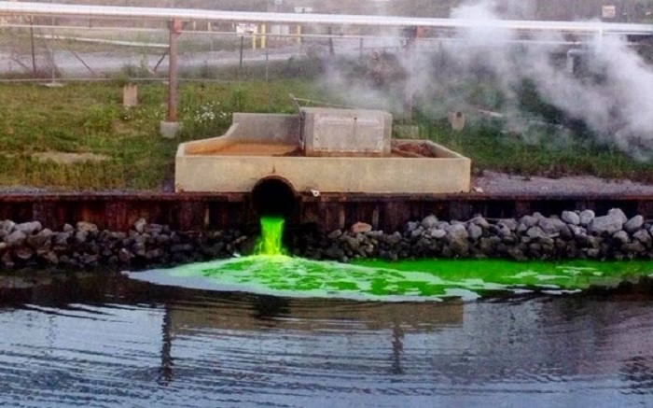
Textile
WATER
Physics
Food
Transport
Klimate
Chemistry
Leisure
Textile

Slide 8
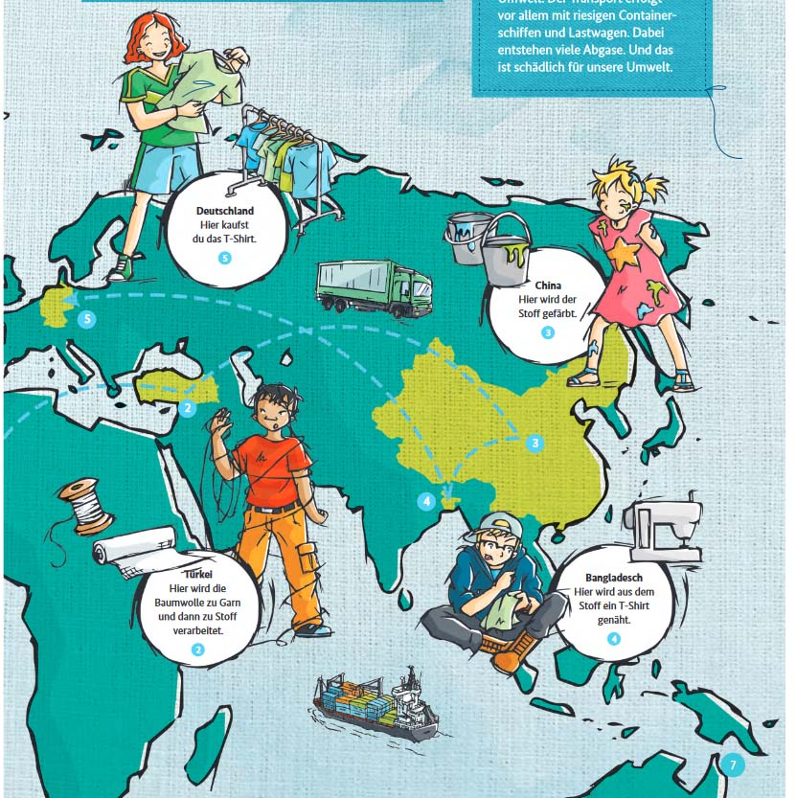
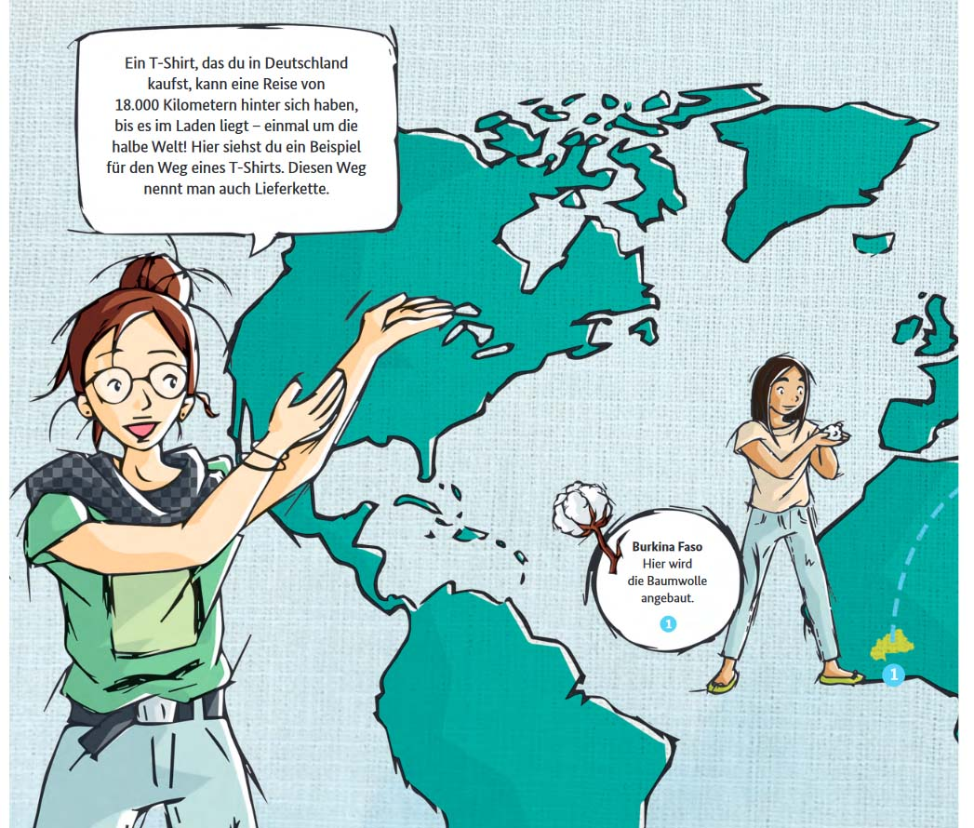
2 Turkey: spinning and weaving
3 China: dye
4 Bangladesh: sewing
5 Europe: buy
A T-shirt that we buy in Europe often has a journey of about 18,000 km behind it - once halfway around the world!
1: Burkina Faso - this is where the cotton is grown

Slide 9
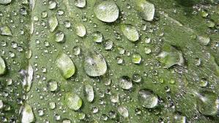
Chemistry
WATER
Physics
Food
Transport
Klimate
Chemistry
Leisure
Textile

Slide 10
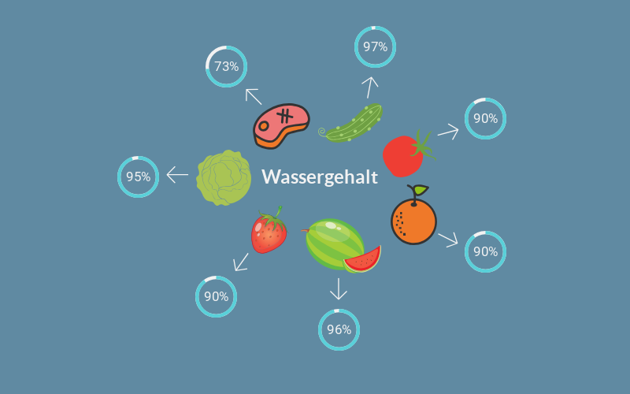
Food
WATER
Physics
Food
Transport
Klimate
Chemistry
Leisure
Textile
Our daily water consumption
Water content
Drinking water
Virtual water in food

Slide 11
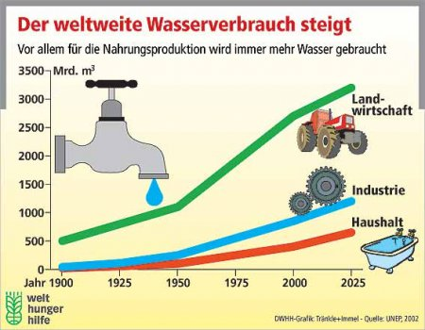
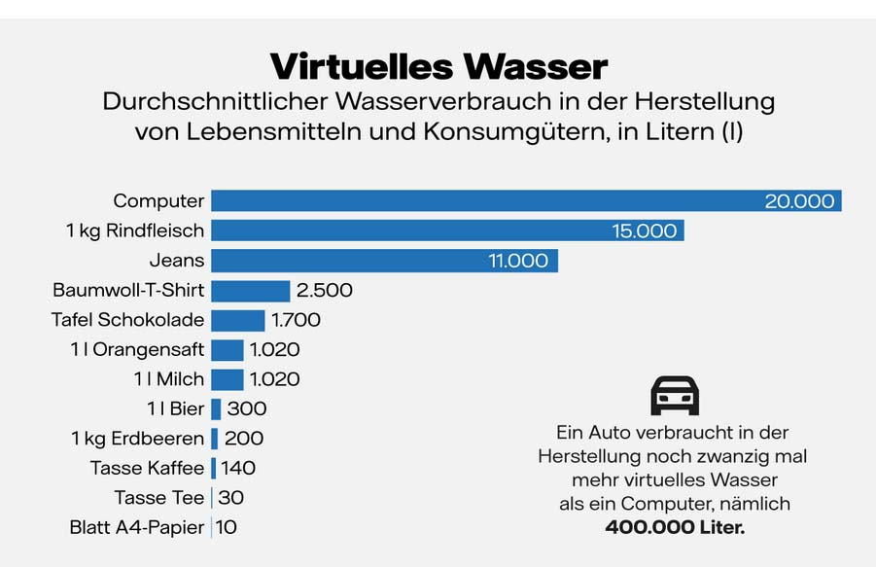
WATER
Physics
Food
Transport
Klimate
Chemistry
Leisure
Textile

Slide 12
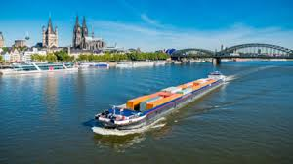
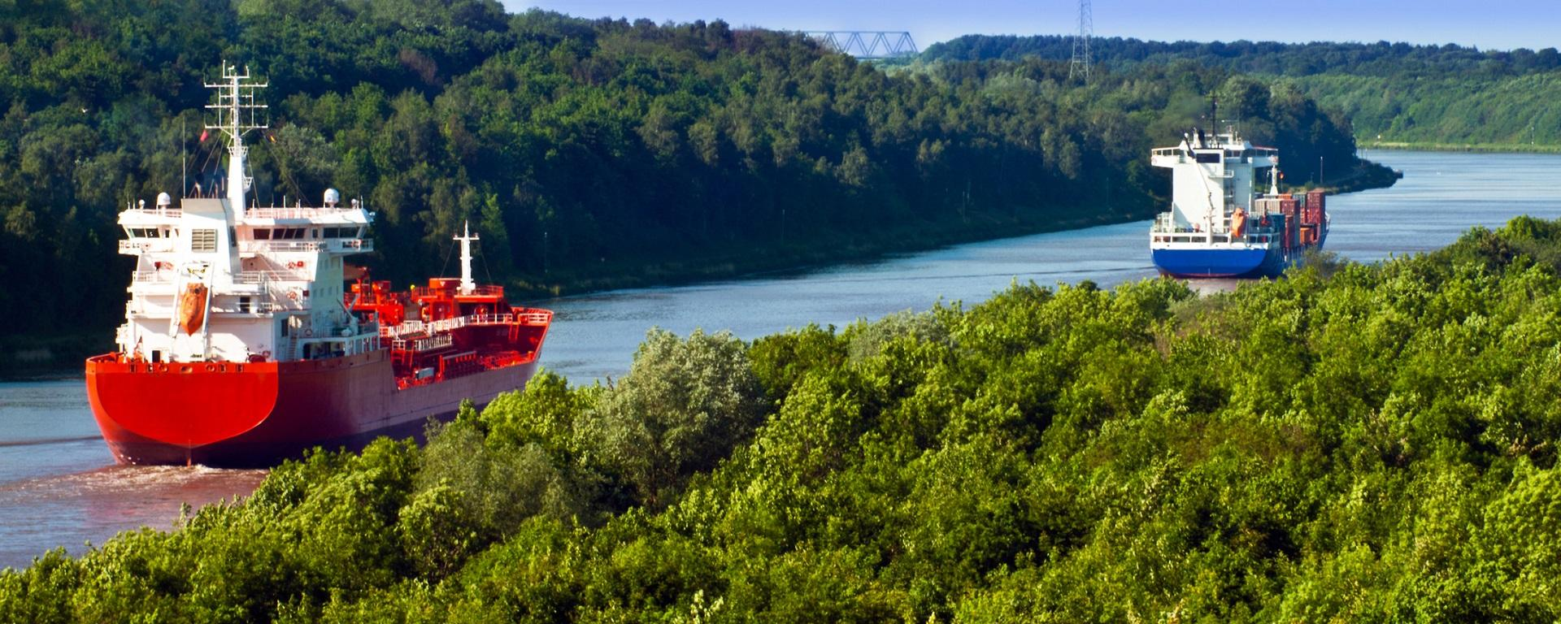
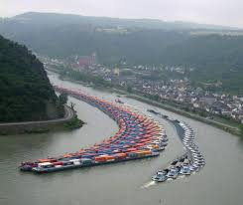
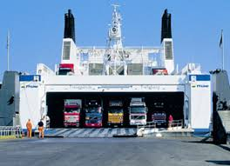
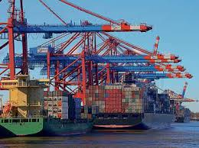
Transport
WATER
Physics
Food
Transport
Climate
Chemistry
Leisure
Textile

Slide 13
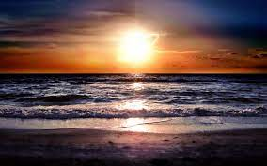
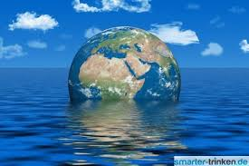
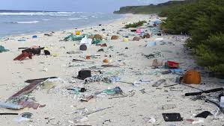
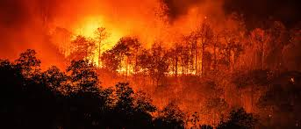
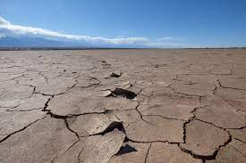
Climate
WATER
Physics
Food
Transport
Climate
Chemistry
Leisure
Textile

Slide 14
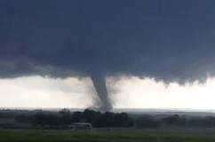
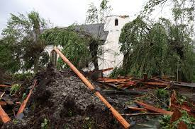
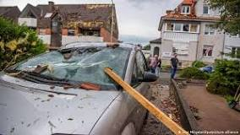
Two Examples from Germany

Slide 15
A dangerous development

