Slide 1
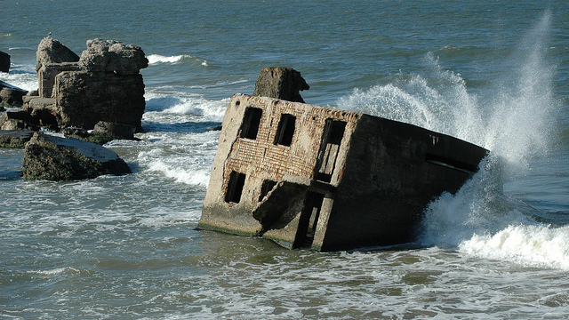
‘Baltic Sea – a glimpse into the future?’
Paderborn, 06.05.2022.

Slide 2
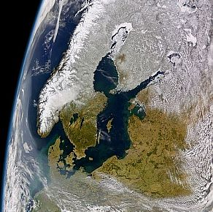
The Baltic Sea Basin on 1 April 2004, as seen from the SeaWiFS satellite (NASA/Goddard Space Flight Center, GeoEye).

Slide 3
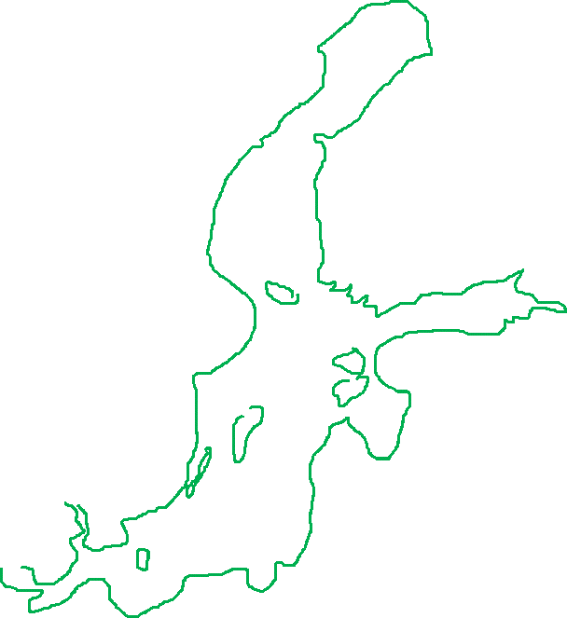
Our Baltic Sea - the outline of the modern Baltic Sea

Slide 4












The inflow of salty and oxygen-rich, nutrient-poor water from the North Sea
and the outflow of nutrient-rich brackish water from the sea
are of great importance for the functioning of the traditional marine ecosystem.

Slide 5

The Baltic Sea has a large catchment area and these are mainly the large rivers.

Slide 6








The rainwater that falls in the catchment area also reaches the sea via the rivers.

Slide 7
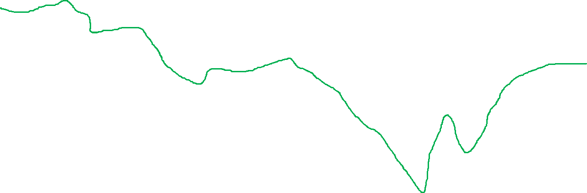
This is the longitudinal cross-section of the sea.

Slide 8



What is interesting is what is shown on this and the following slides: the salty, cold water of the North Sea creeps along the surface of the Baltic Sea floor.

Slide 9


This water is heavier, which is why it drifts downwards.

Slide 10



Such a mechanism supplies the deepest ocean sinks with oxygenated salt water.

Slide 11




In the northern part of the Baltic Sea, near the border with the Gulf of Bothnia (between Sweden and Finland), the heavy salt water causes upwelling.

Slide 12

It then mixes with the less salty upper layer of water.

Slide 13

Now the reversal process takes place and the water flowing in from the North Sea continues on its way, now in the other direction: back to the North Sea.

Slide 14
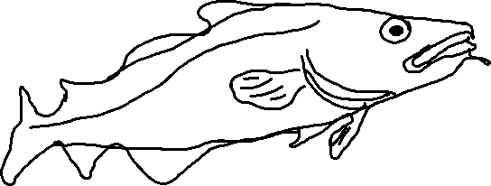
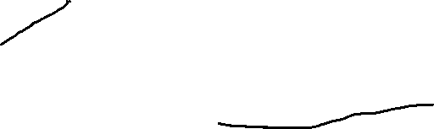
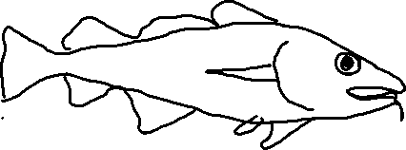
In such an ecosystem, the classic sea dwellers, the benthic fish - the Baltic cod - feel at home.

Slide 15
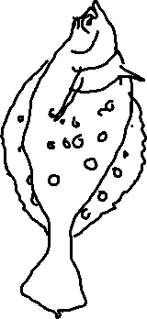
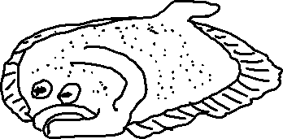
Here are the classic sea creatures:
Baltic cod (centre)
Turbot (left)
Baltic flounder (right)
for which such an ecosystem is an ideal habitat.

Slide 16
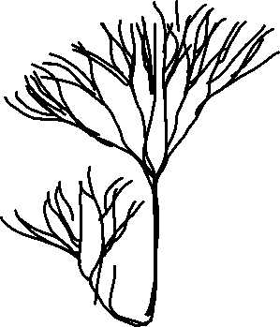

The stability of the Baltic Sea ecosystem was maintained by two other important players:
the alga Furcilaria. Furcilaria algae use fertilisers dissolved in the water to grow and their meadows are excellent spawning grounds and nurseries for small fish.

Slide 17

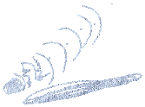
2. the mussels. Mussels ensured that the water was filtered by small creatures, which made the water clear and they themselves served as food for flounder and Baltic cod.

Slide 18
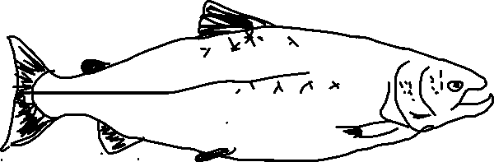
In addition, the sea was rich in very valuable and famous Baltic salmon.

Slide 19
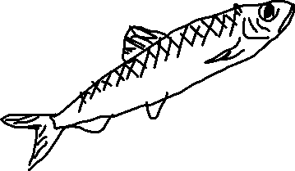
Apart from the fish already mentioned, Baltic herring were very important to the fishermen.

Slide 20
The oligotrophic ecosystem of the Baltic Sea was a simple but brilliant masterpiece of nature.

Slide 21
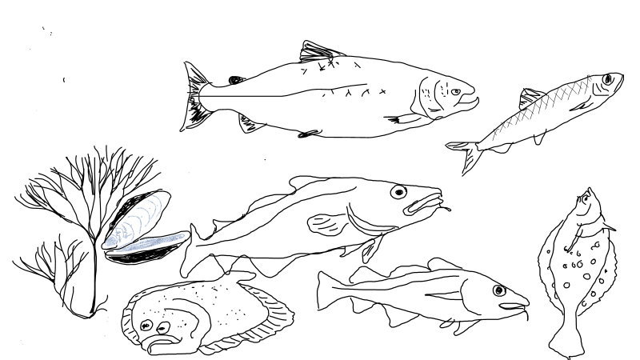
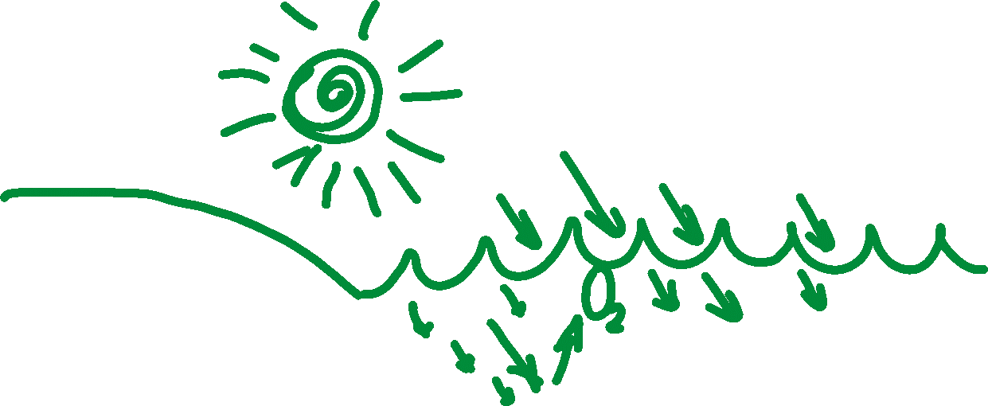
The solar energy ensured the growth of Furcellaria algae. And these in turn consumed the fertilisers dissolved in the water and released oxygen.
The amount of fertiliser that flowed from the shore into the Baltic Sea was small, but sufficient to keep the system in operation. .

Slide 22
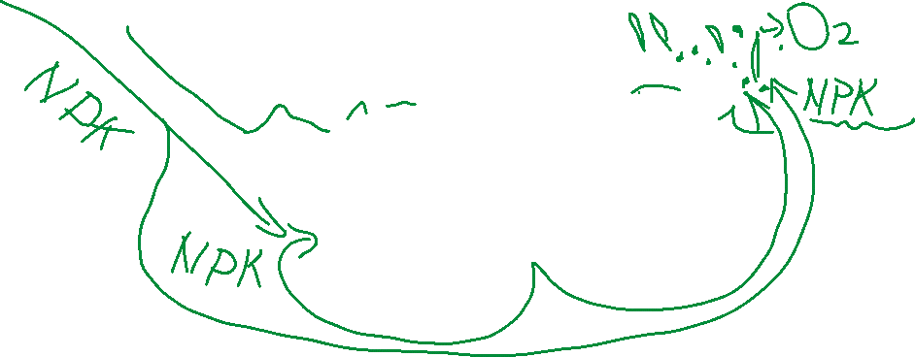
Such a system could function flawlessly for an unlimited period of time.

Slide 23

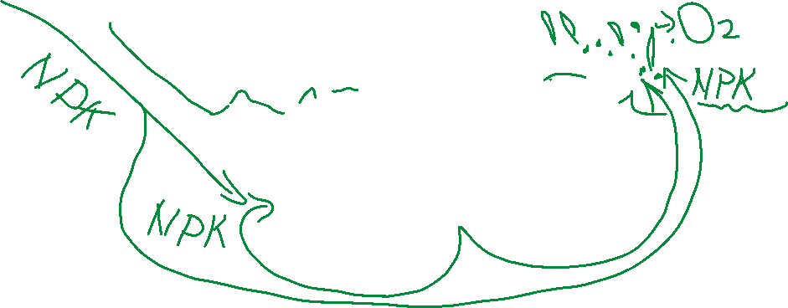
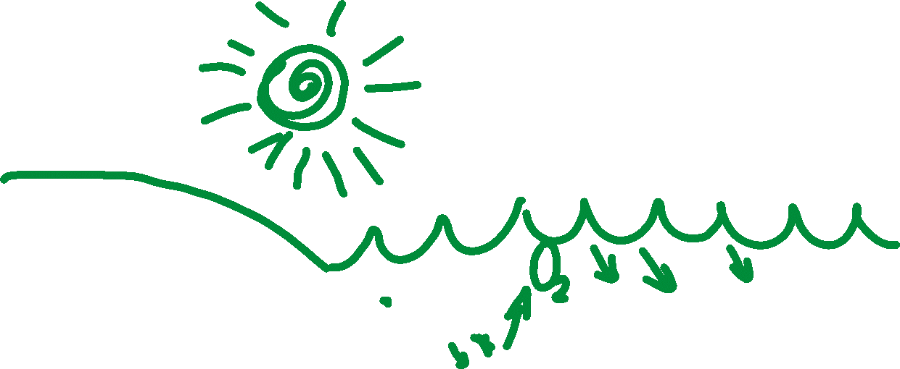
Der Fischreichtum der Ostsee war eine wichtige Nahrungsquelle für die Küstenbevölkerung.

Slide 24
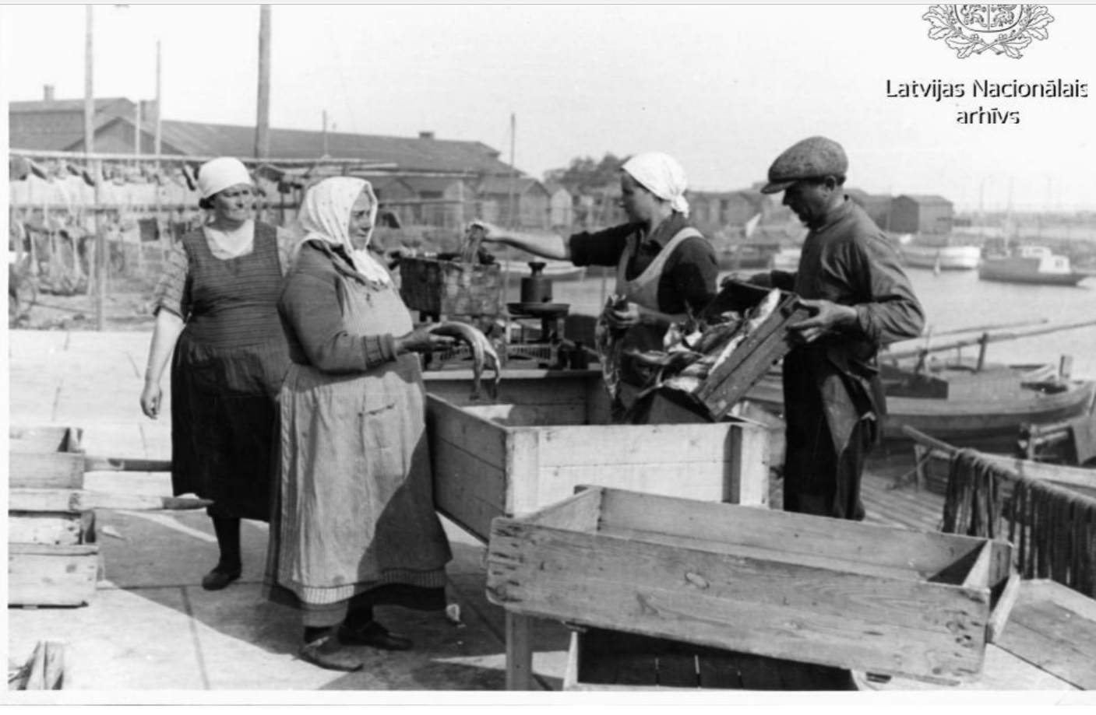
Fish market, Liepāja, 1936
Fishing was also an important source of income.

Slide 25

However, more and more fertilisers are being released into the sea as a result of intensive agriculture.
The marine ecosystem was simple, resilient and efficient and continued to convert this fertiliser into valuable food.

Slide 26
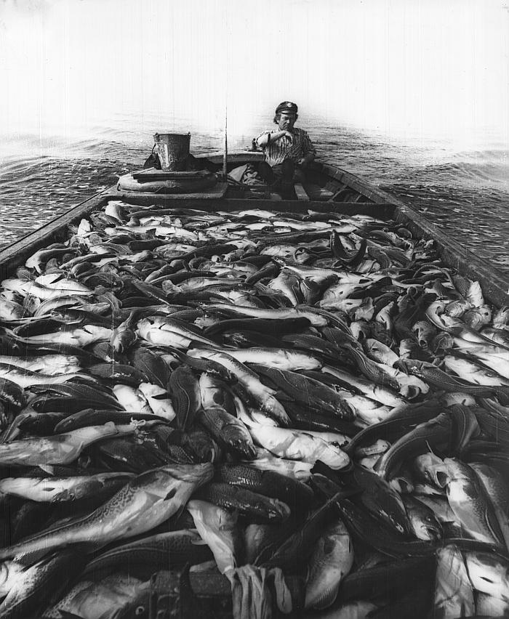
Cod fishing 1970-80
Foto – Arvīds Mitrēvics
However, small signs of water over-fertilisation were already visible, as the seawater could certainly ‘bloom’ more during the warm season.

Slide 27

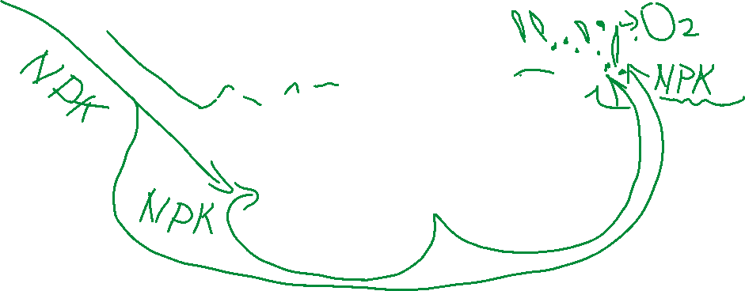
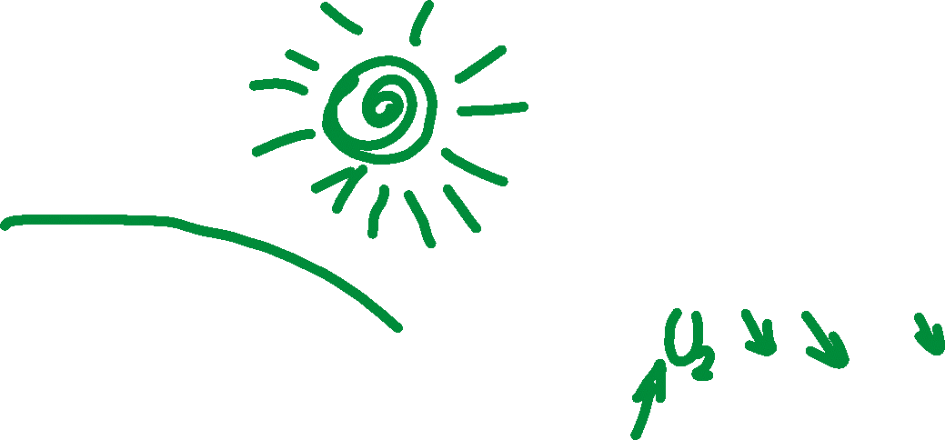
The influx of fertilisers continued to increase, as a result of which the members of the marine ecosystem did their work even more diligently.

Slide 28
The mussels diligently filtered the multiplied microorganisms and kept the water transparent. As the transparent water let in plenty of sunlight, the Furcellaria algae were able to grow abundantly as they consumed the NPK fertiliser (nitrogen, potassium, phosphorus) introduced into the sea.
The herring continued to spawn by seeding the Fucellaria meadows with roe pearls.
He could be sure that the oxygen-rich salt water promoted their development.
Flounders could enjoy the mussels. And everything was almost ideal.

Slide 29
As has now become clear, the key to this system lies in the performance of Furcellaria algae and mussels.

Slide 30
These are the most important players for maintaining the balance of the ecosystemies.

Slide 31
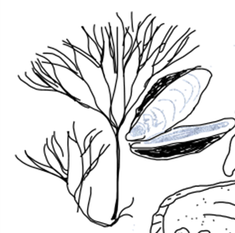
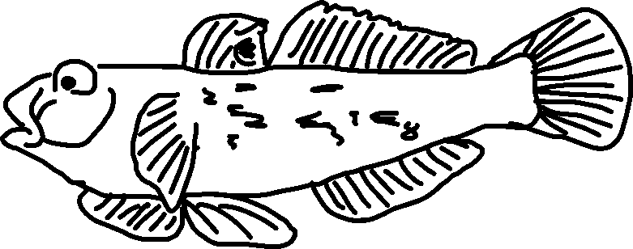
Around 2004, an unwanted guest - the blackmouth goby –
was brought into the Baltic Sea in the ballast water of oil ships.

Slide 32
It was found that the blackmouth goby really likes mussels and feels very comfortable in the less salty waters of the Baltic Sea.

Slide 33
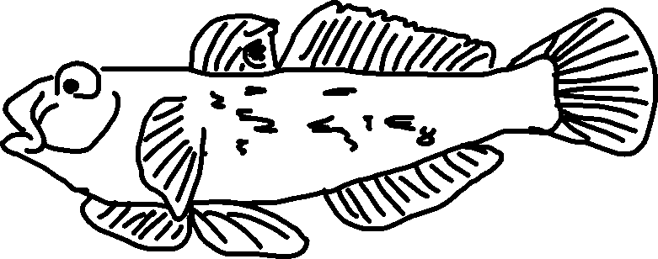
This invasive species eats almost all mussels and thus disrupts the harmonious system.

Slide 34


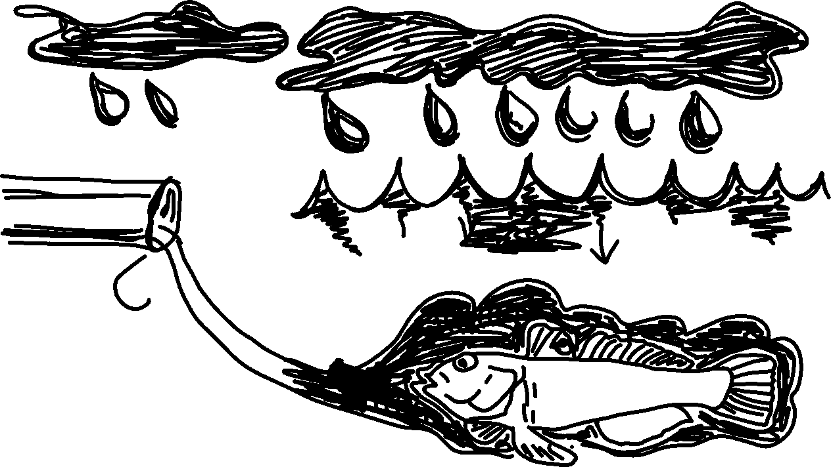
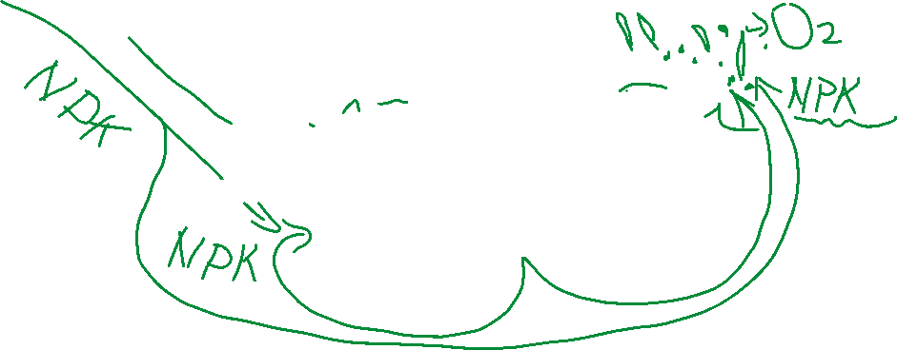
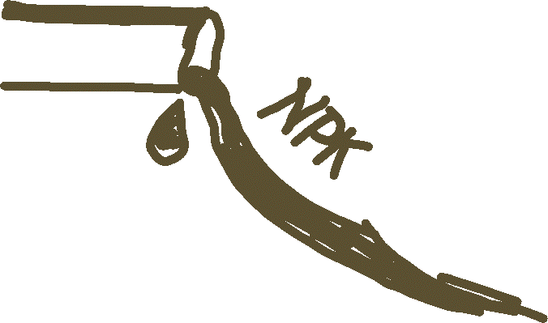

The fishermen start a battle with the stranger by catching these fish in large quantities and offering them as food, but it's too late ...
the Baltic Sea has given up!!!

Slide 35
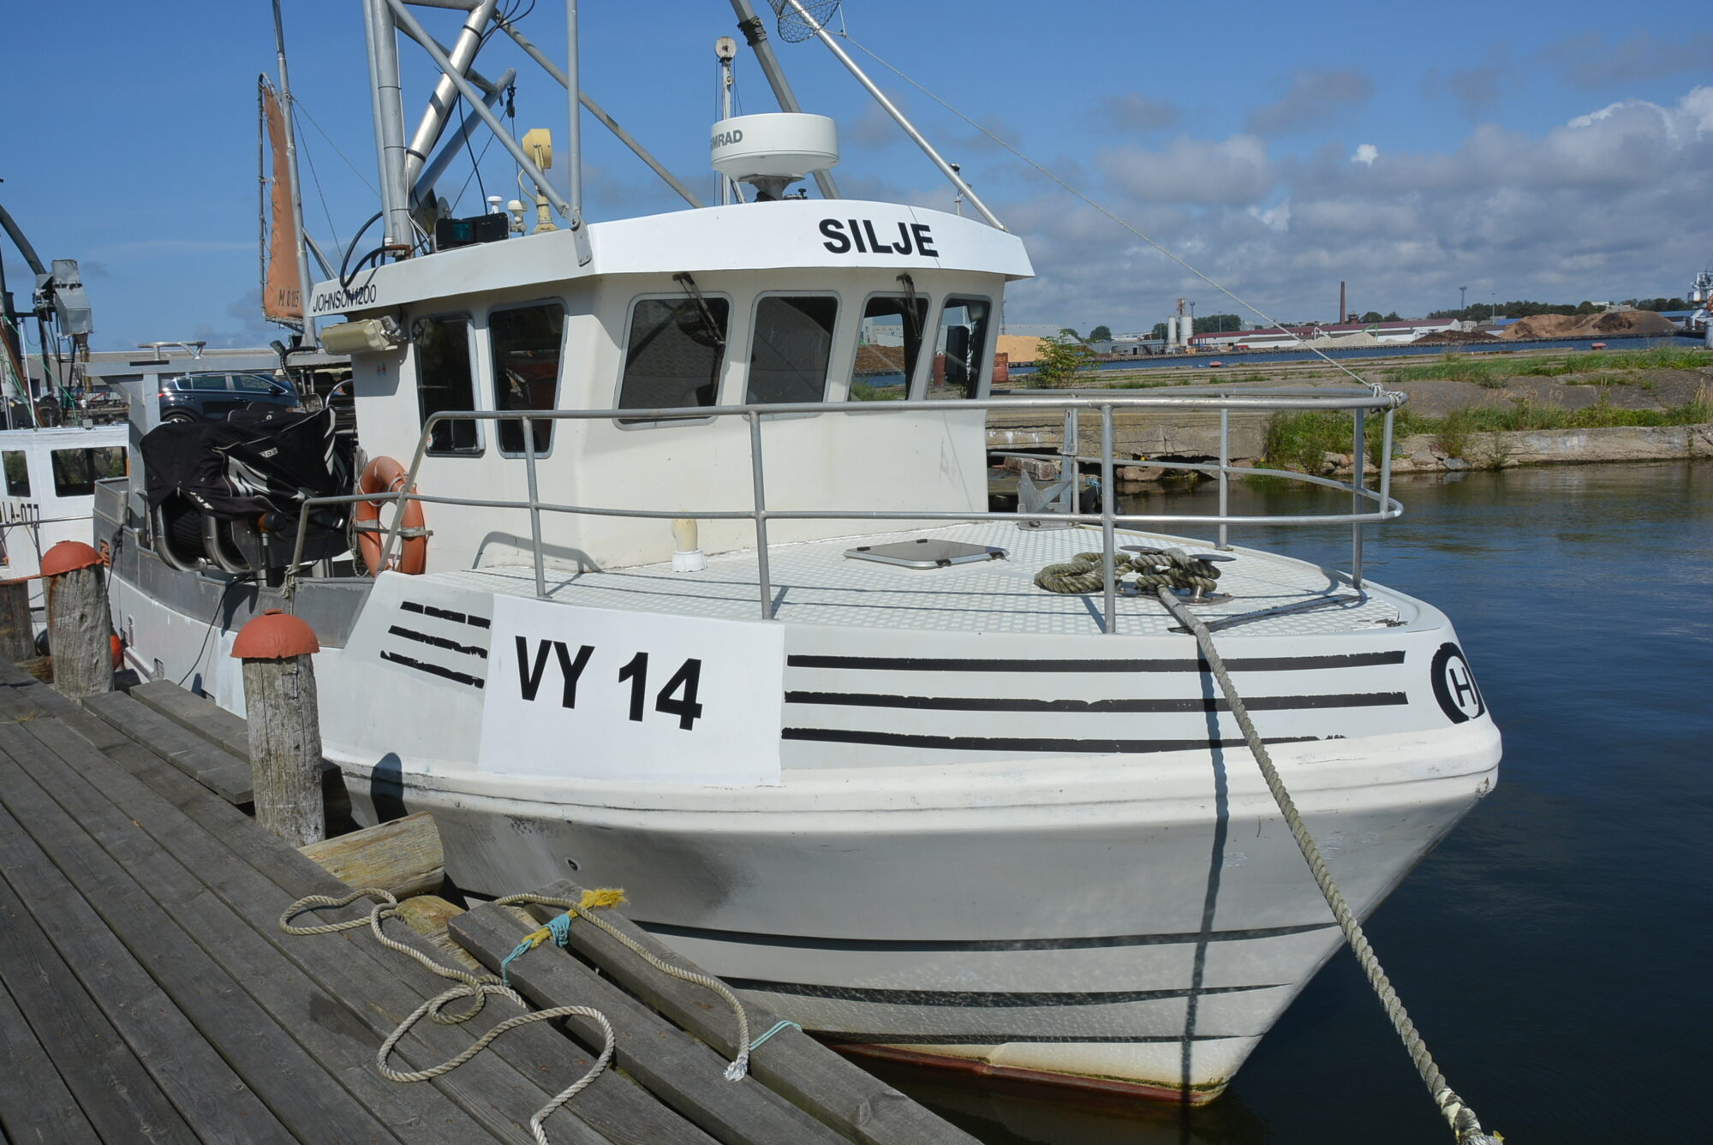
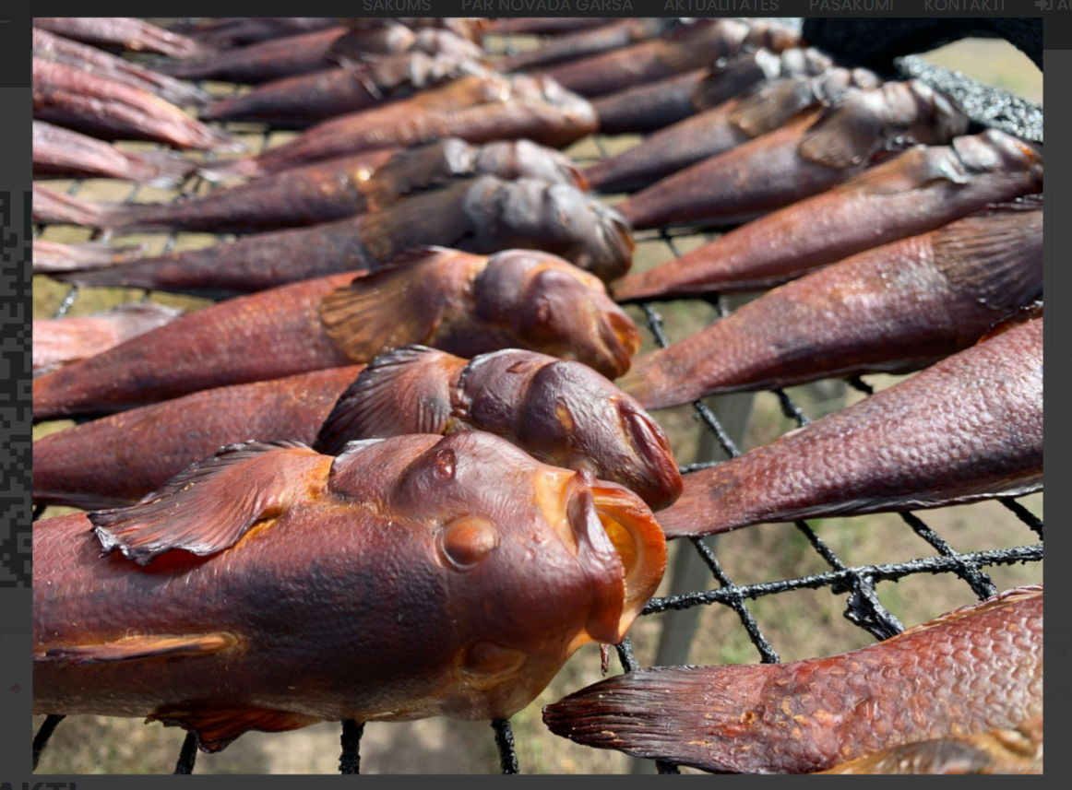
Fishery Oskars 2022

Slide 36
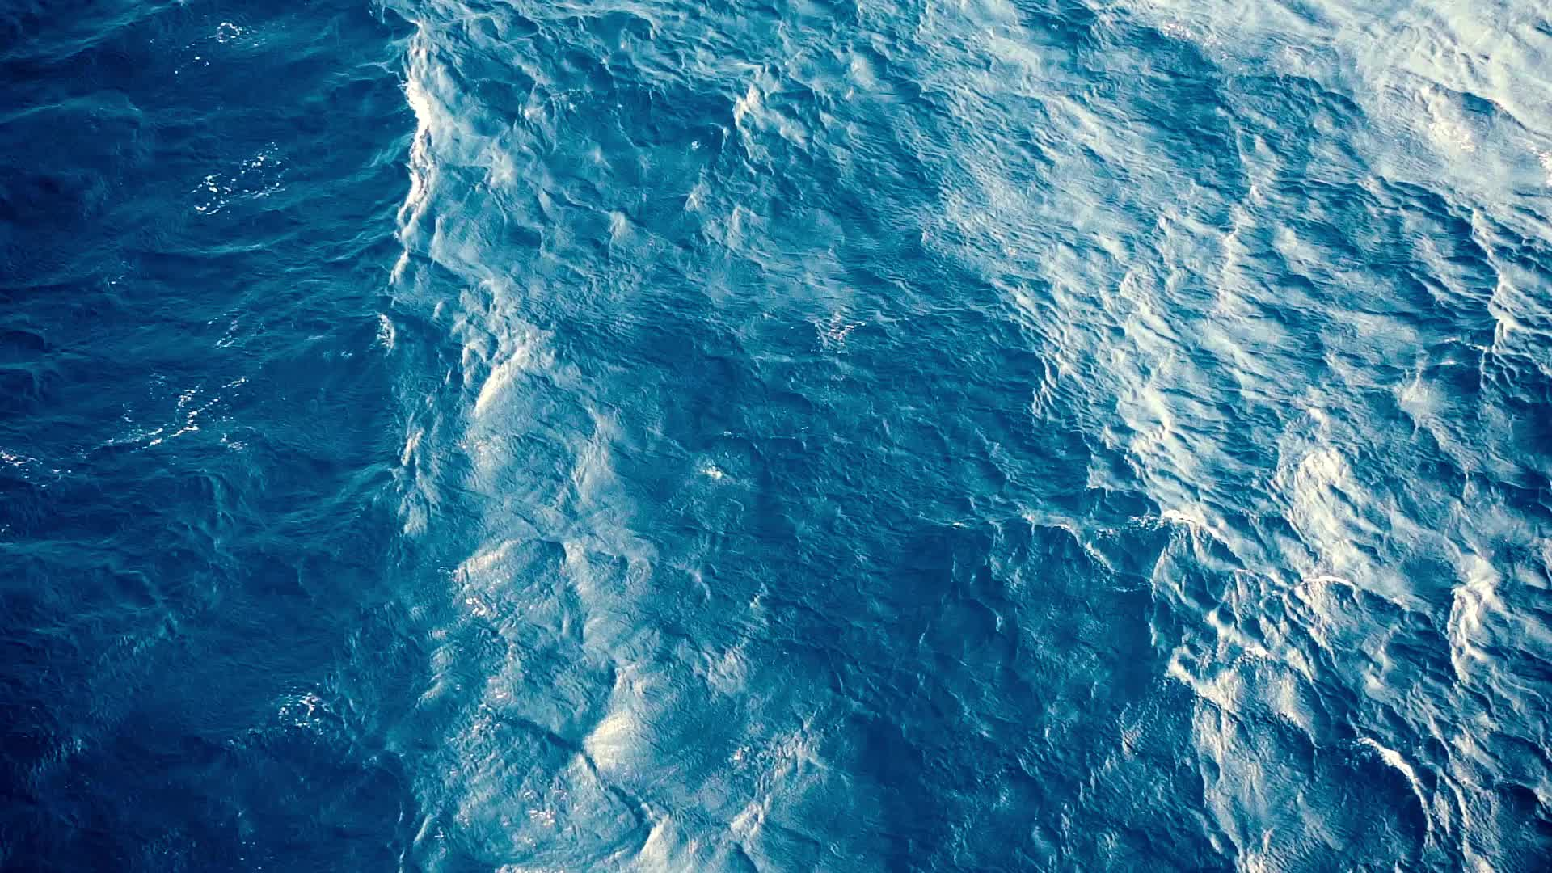
Changes that were expected for the oceans have already occurred in the Baltic Sea. The researchers cite water temperature as an example. While the oceans have warmed by an average of 0.5 degrees Celsius over the past 30 years, measurement series for the Baltic Sea show a warming of around 1.5 degrees Celsius over the same period.
The researchers point out that there are now also pronounced oxygen-free zones in deep areas of the Baltic Sea. Their extent has increased tenfold over the past century. The acidity (pH value) of the Baltic Sea water already regularly reaches values that were not expected until the next century as a result of ocean acidification in deeper oceans.
Source: https://www.n-tv.de/wissen/Ostsee-zeigt-Forschern-die-Zukunft-article20431214.html

Slide 37
‘This unique brackish sea can serve as a kind of time machine that allows us to better predict future global developments’
Thorsten Reusch, Geomar Helmholtz-Zentrum für Ostseeforschung, Kiel

